Slide 1
On the Frame of Reference in Flow Visualization
Philipp Jung
Master’s Thesis
Supervisor: Prof. Dr. Filip Sadlo
Heidelberg University, Visual Computing Group
Heidelberg, March 22, 2019

Slide 2
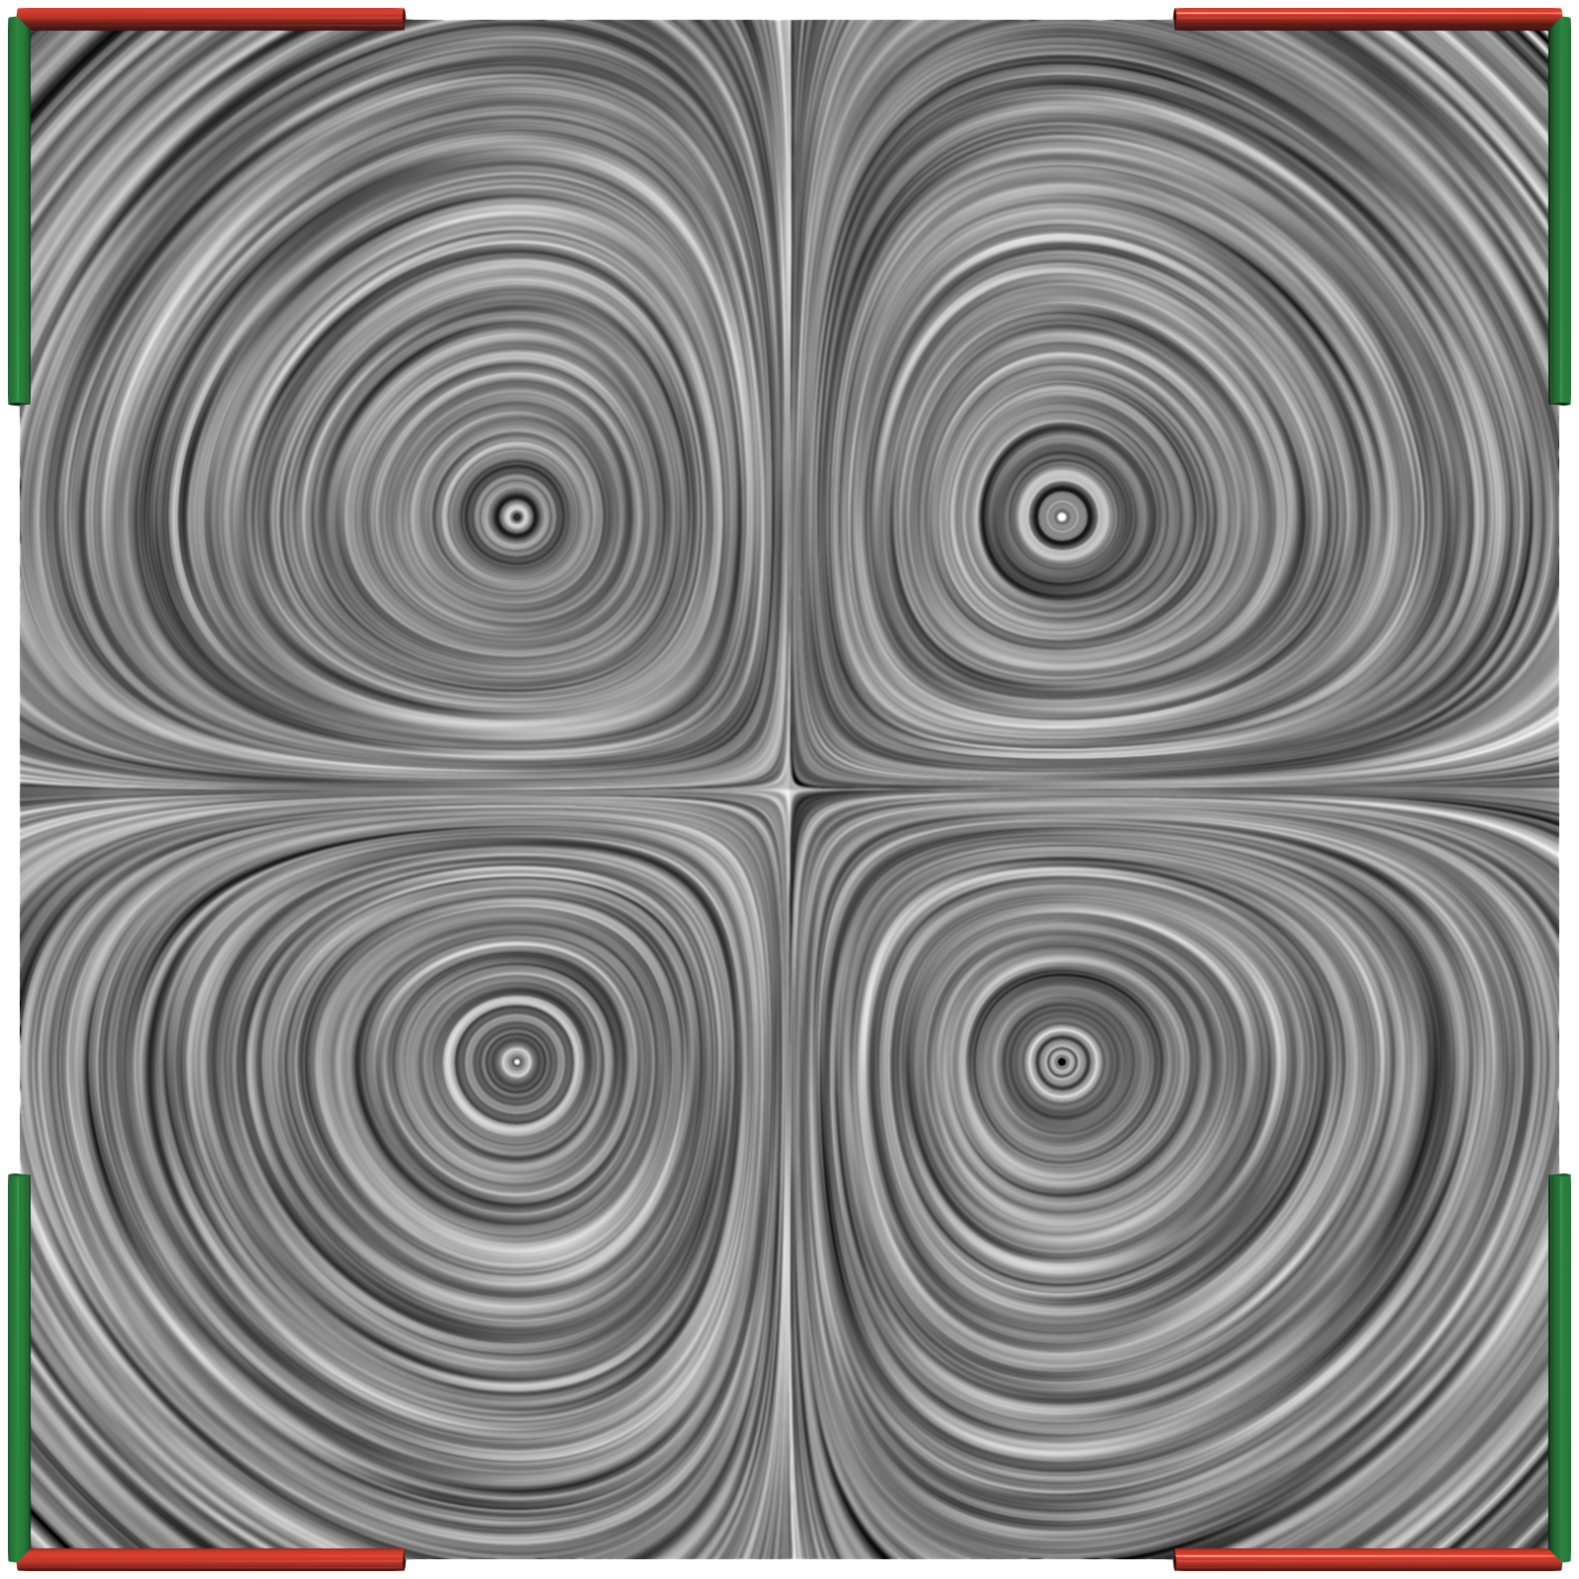
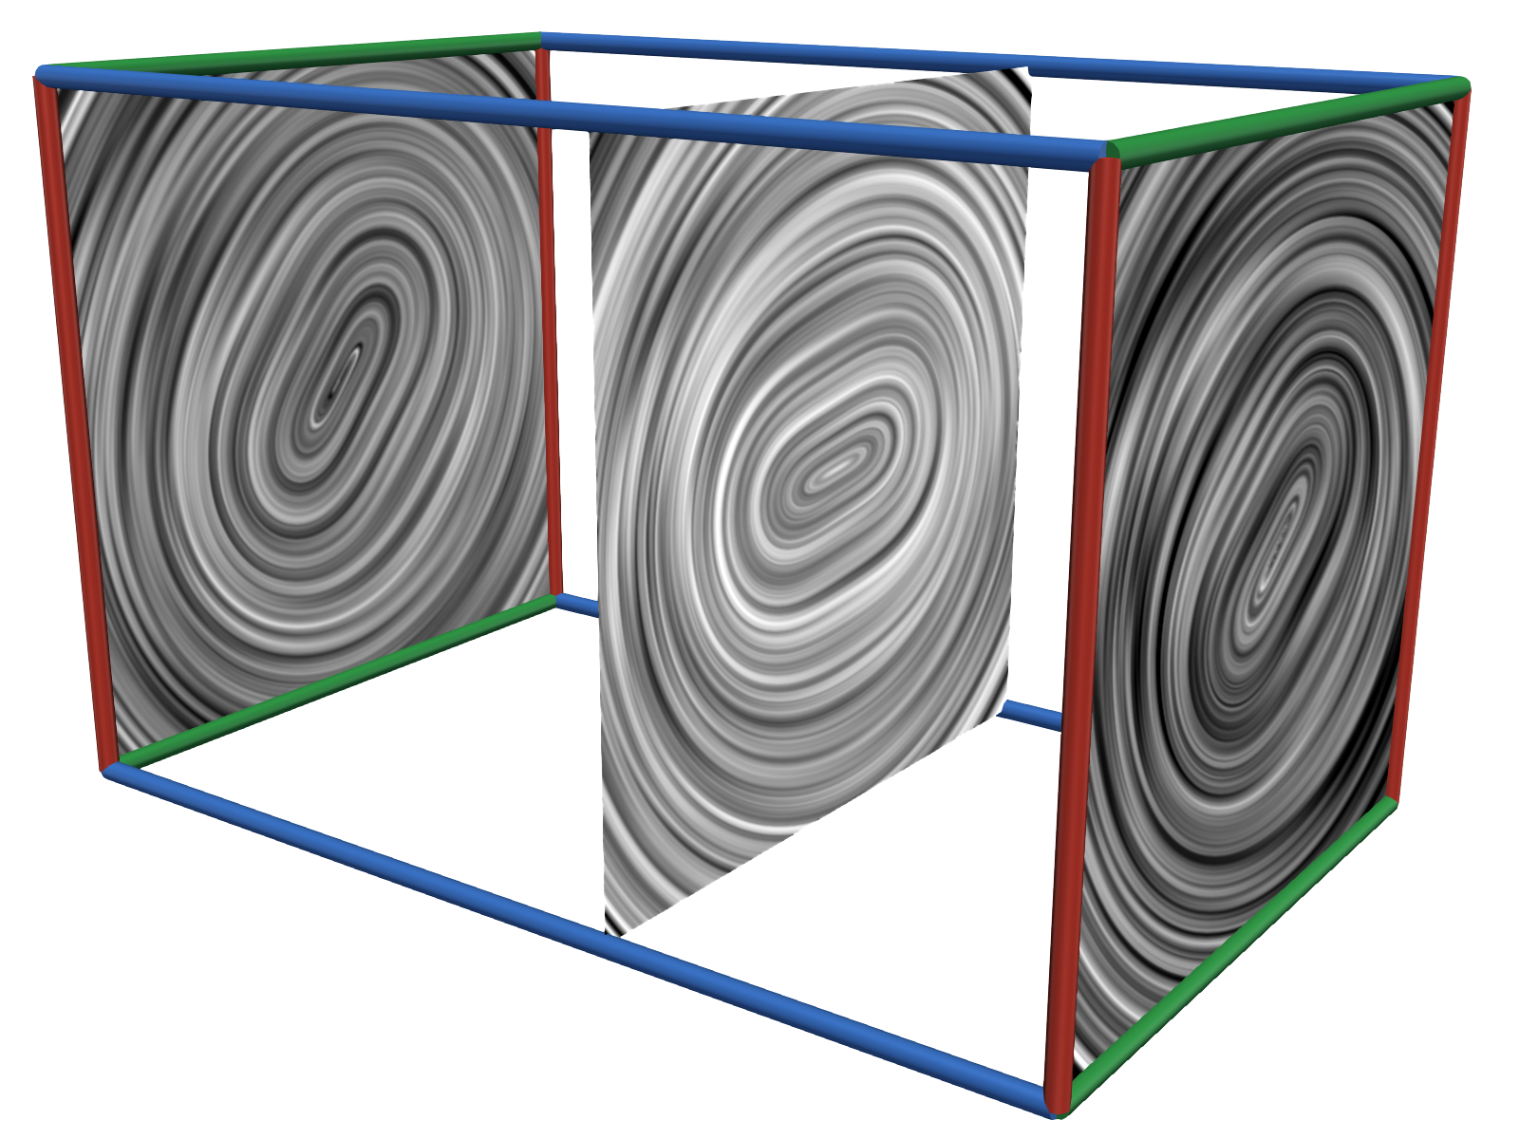
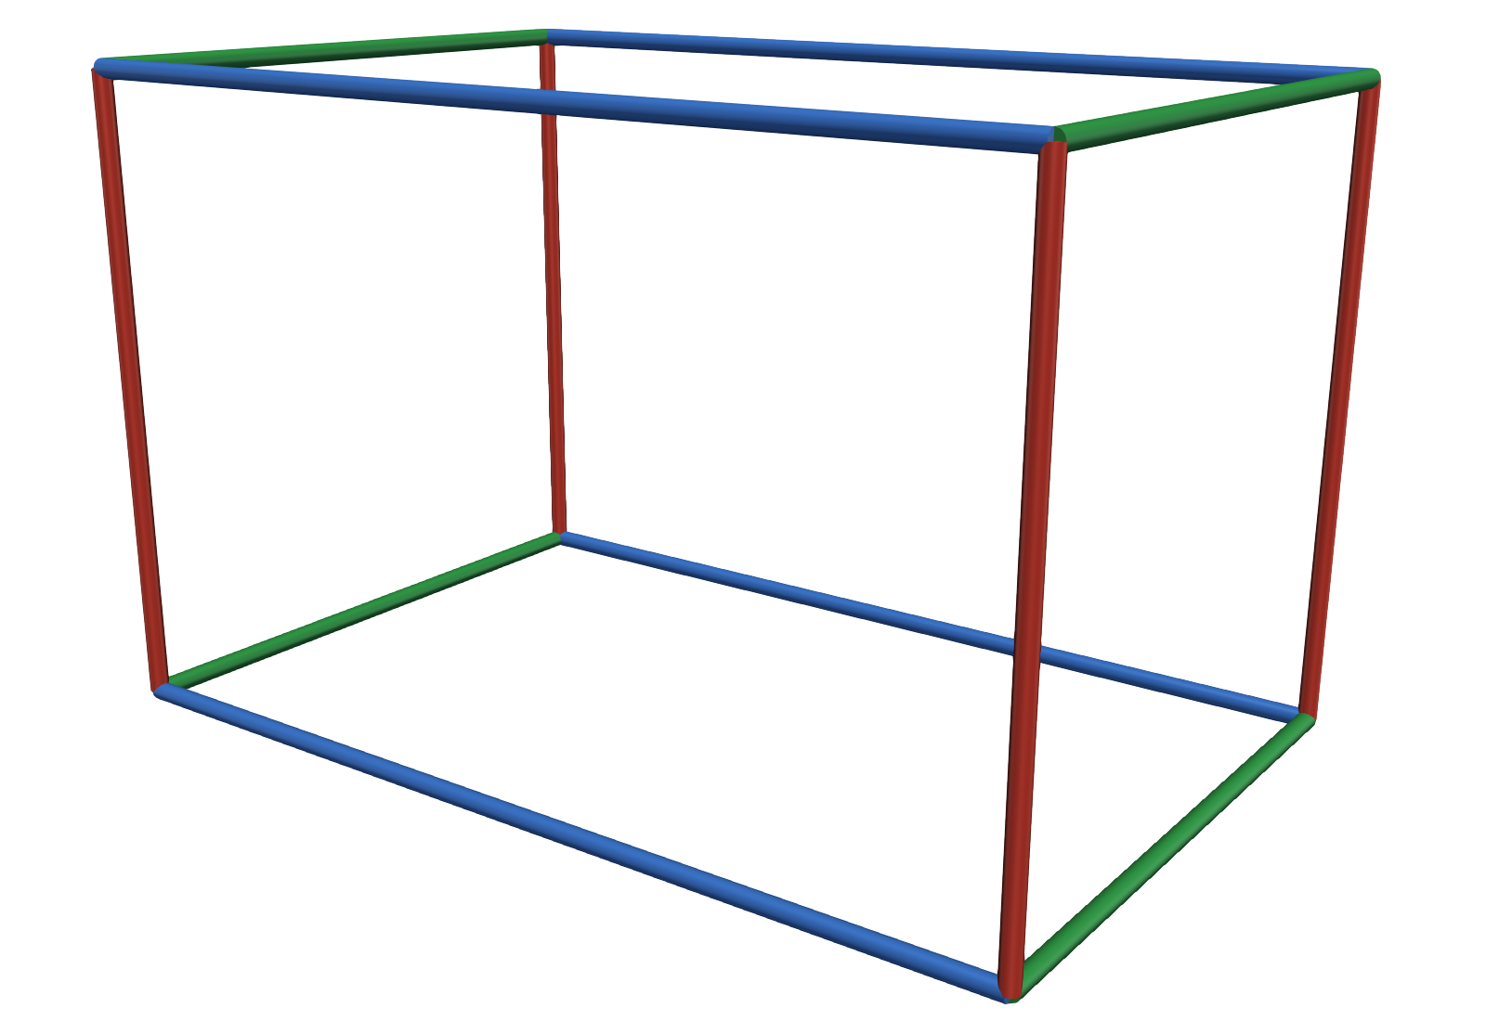
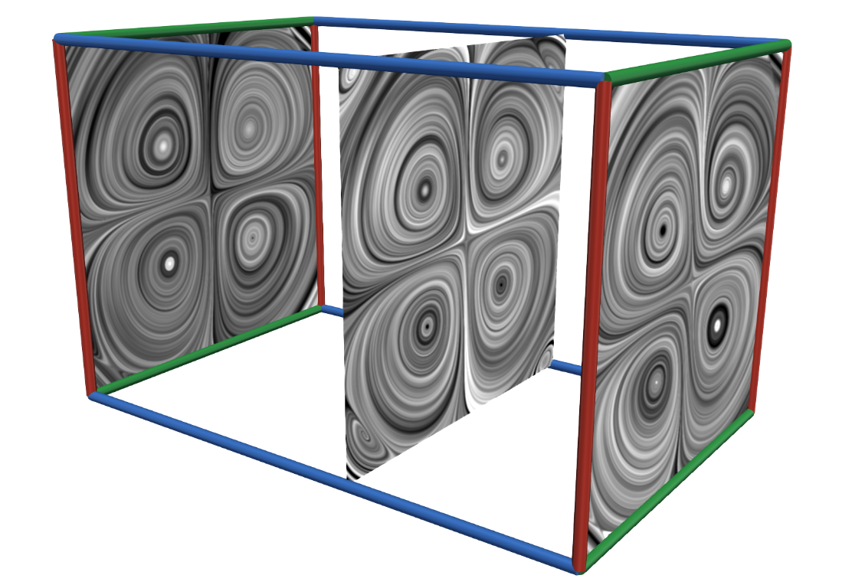
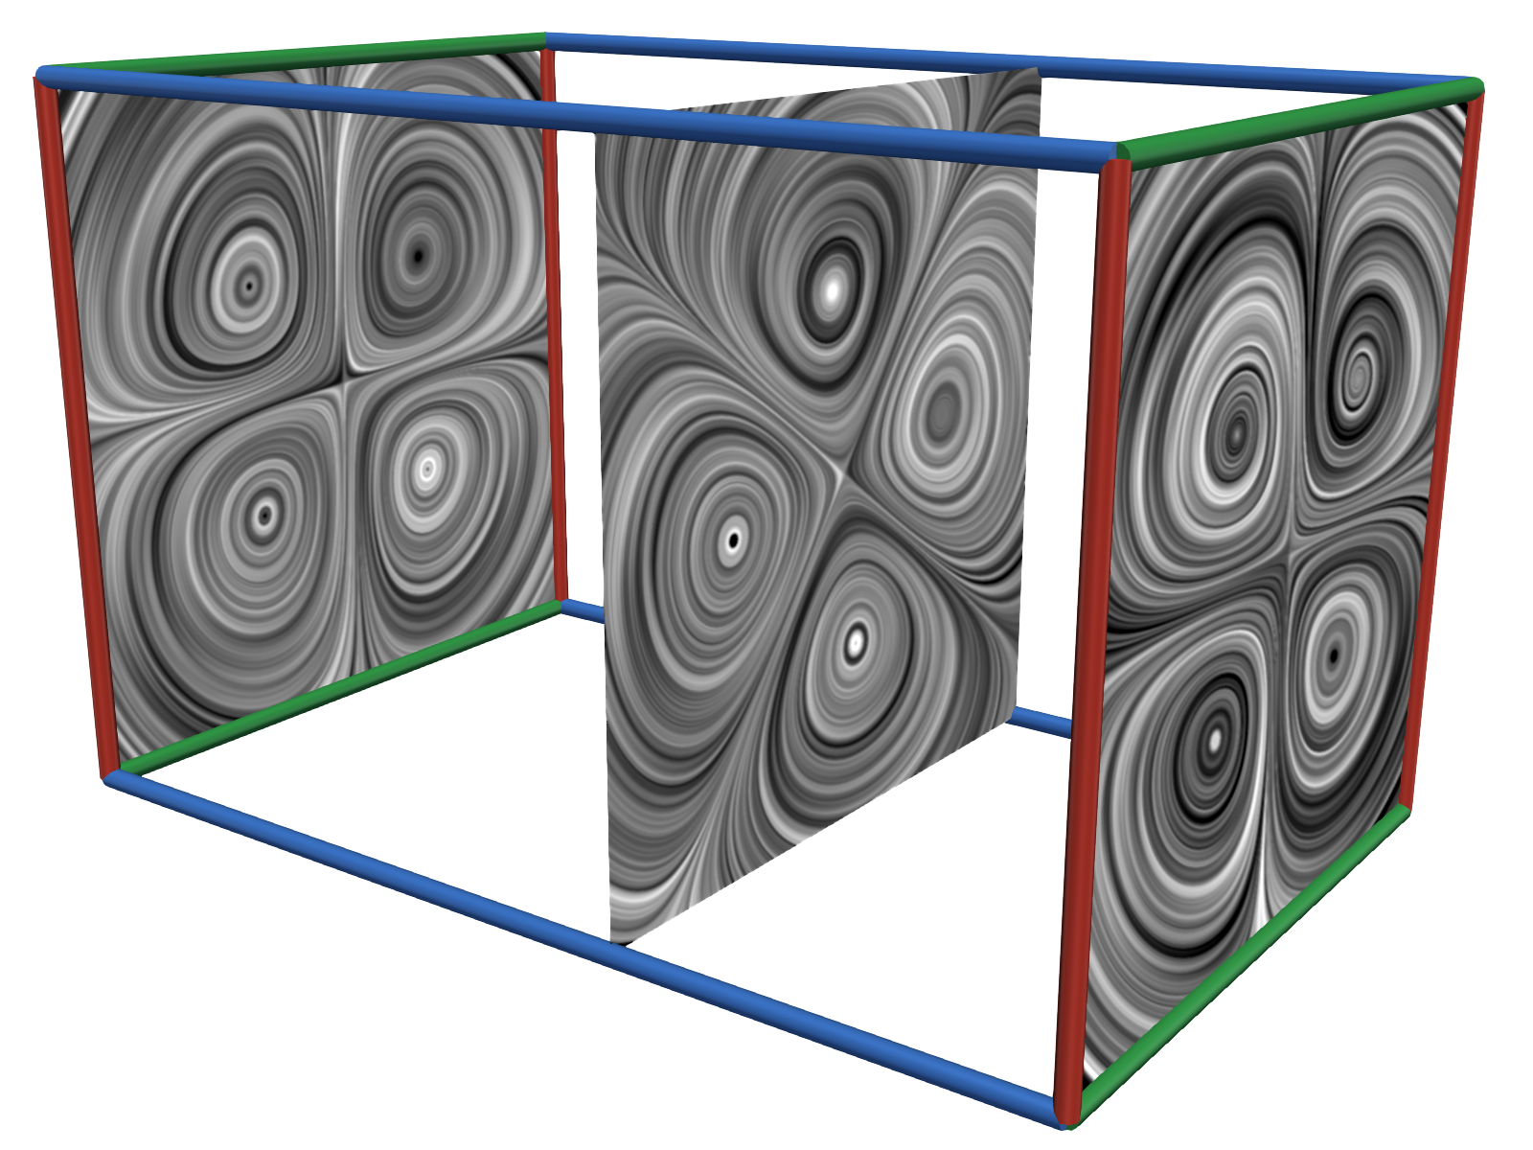
Motivation
Steady
Observer
Time-dependent
$$∘$$
=
Time
=
[Günther et al. 17/18]
[Hadwiger et al. 2019]
$$∘$$
Time
Time
Time
Time
Time-dependent
Observer
Steady

Slide 3
Motivation
Q1. Can a vector field always be decomposed in an observer and a steady field?
Q2. Can techniques be transferred from the steady to the time-dependent case?
Techniques
=
[Günther et al. 17/18]
[Hadwiger et al. 2019]
$$∘$$
Time
Time
Time
Time
Time-dependent
Observer
Steady

Slide 4
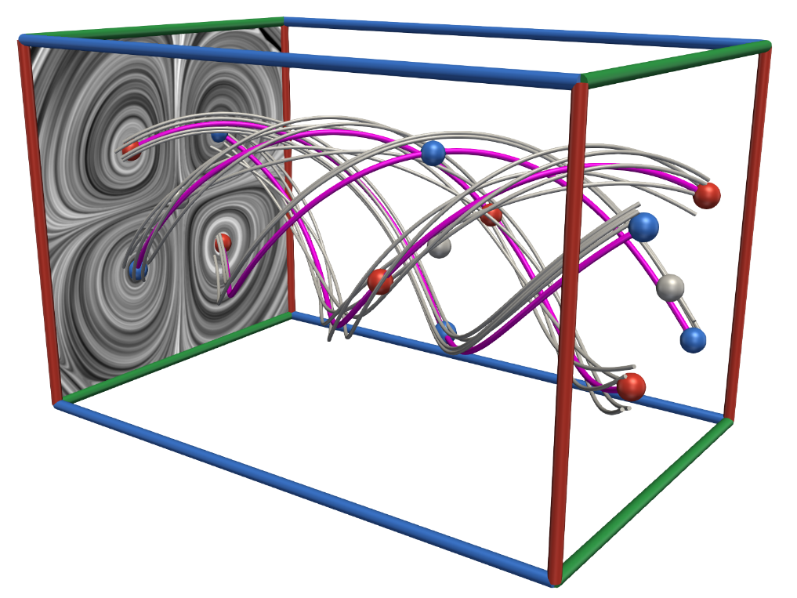
Motivation
Q2. Can techniques be transferred from the steady to the time-dependent case?
Features from steady $→$ time-dependent
Vortex core lines [Günther et al. 17/18, Hadwiger et al. 2019] ✔
Vector field topology?
Techniques
=
[Günther et al. 17/18]
[Hadwiger et al. 2019]
$$∘$$
Time
Time
Time
Time
Time-dependent
Observer
Steady

Slide 5
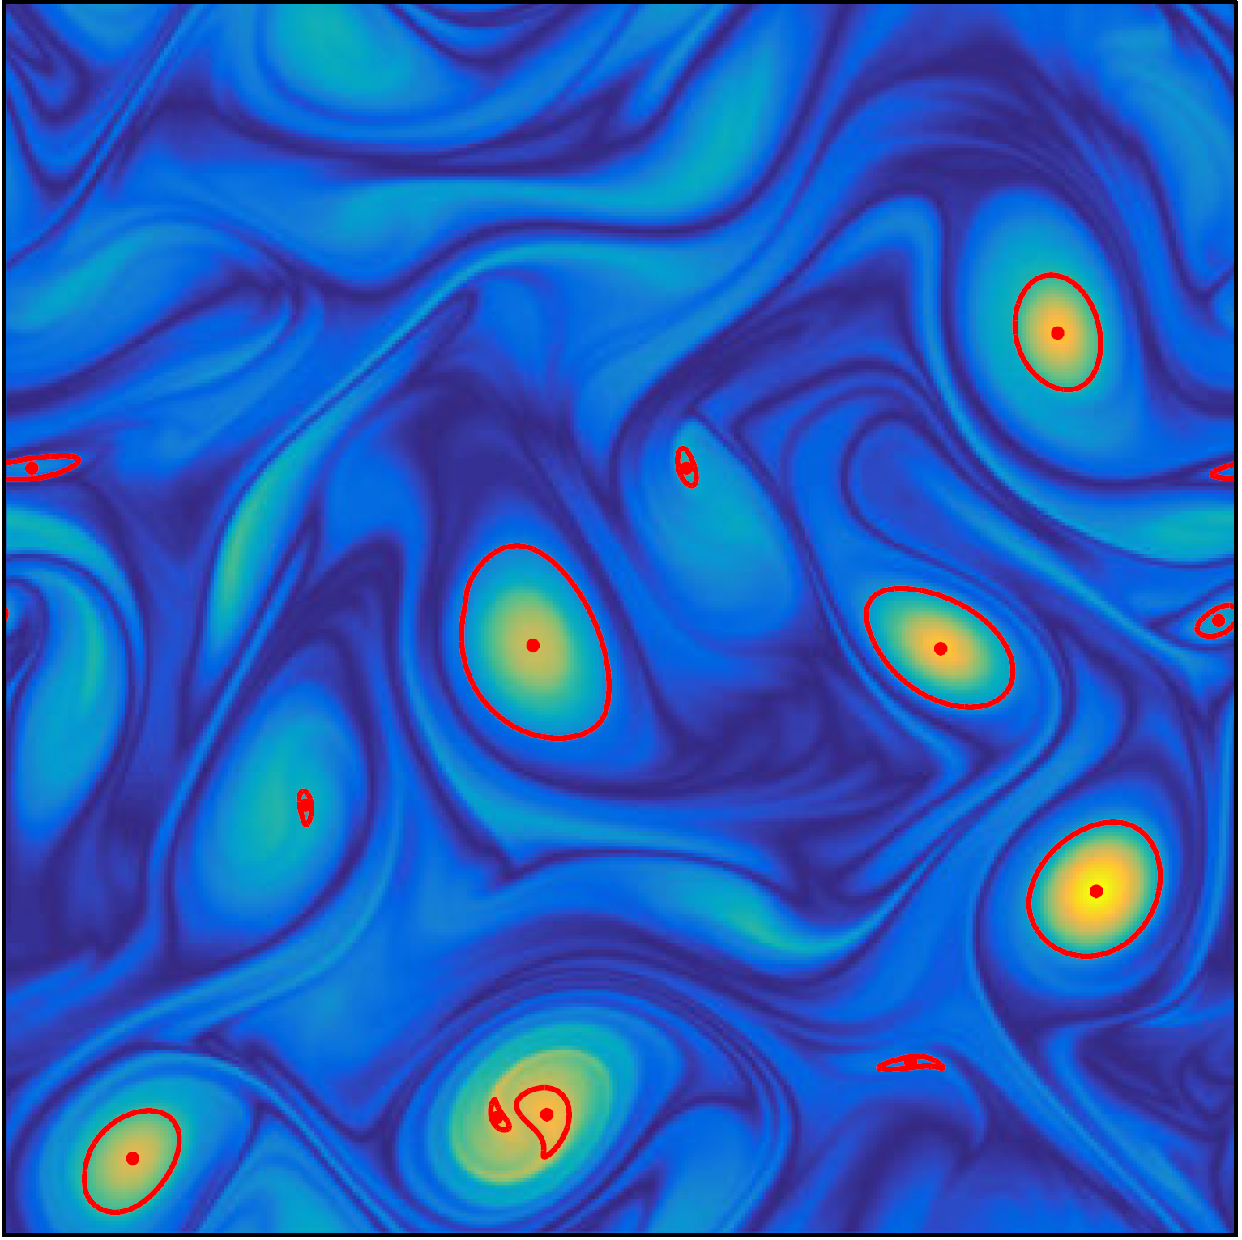
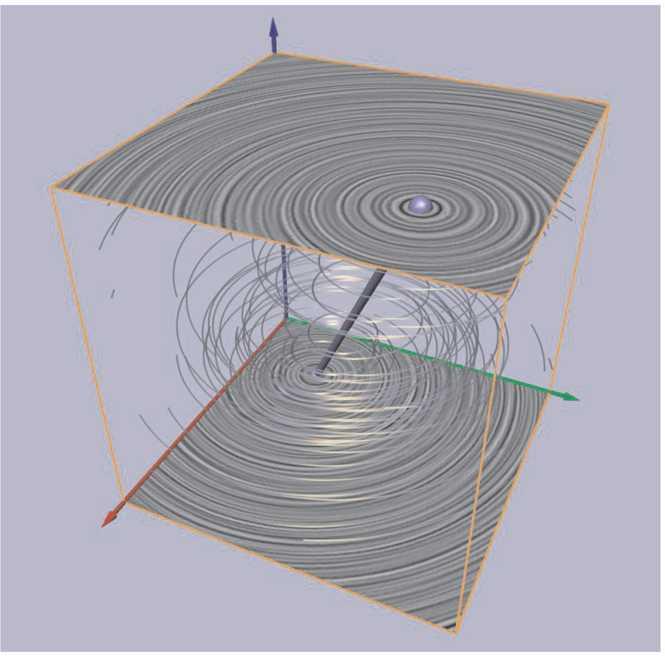
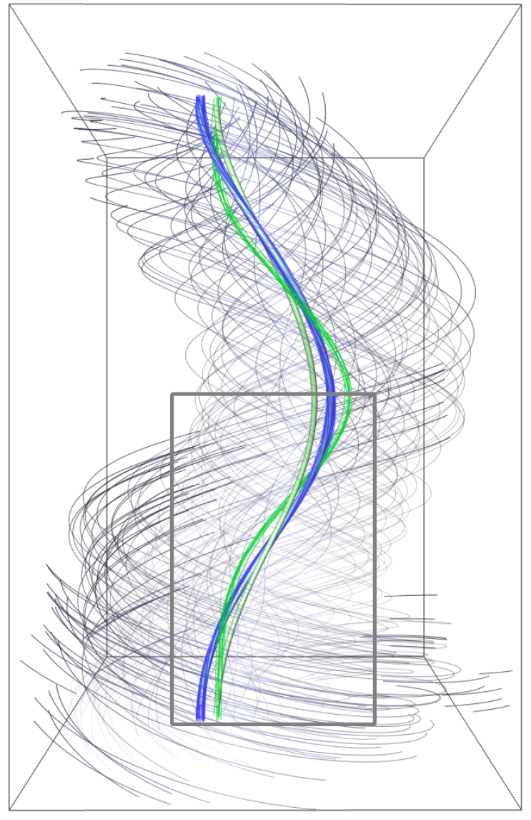
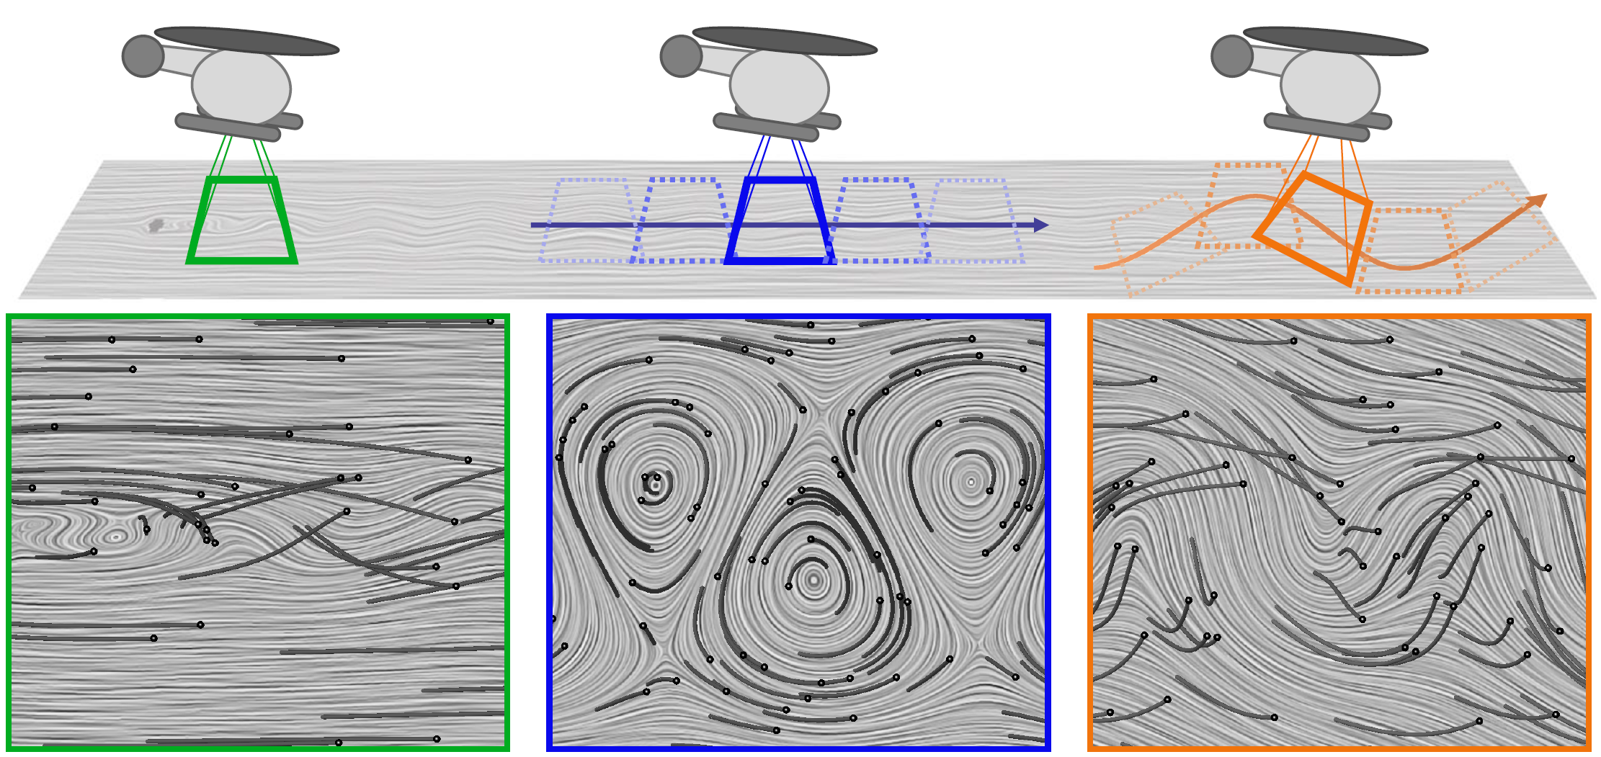
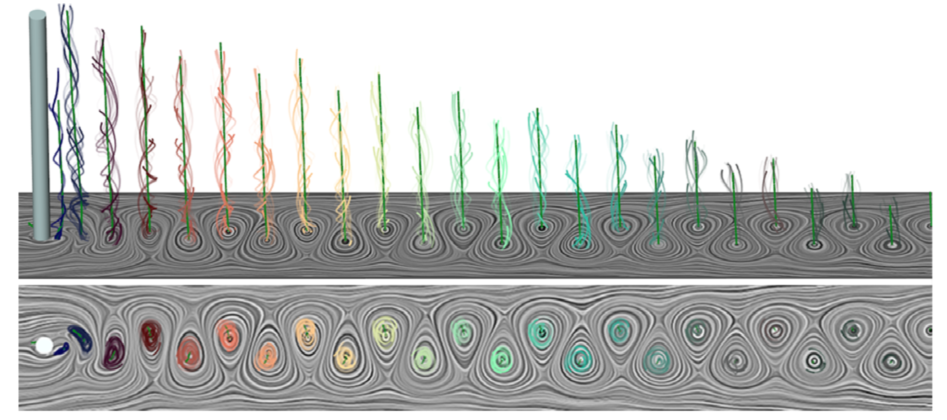
Related Work
Single observer
[1] Coherent Vortices from Objective Vorticity [Haller et al. 2016]
Multiple observers
[2] Cores of Swirling Particle Motion [Weinkauf et al. 2007]
Local neighborhood-based
[3] Rotation Invariant Vortices [Günther et al. 2016]
[4] Generic Objective Vortices [Günther et al. 2017]
[5] Hyperobjective Vortices [Günther & Theisel 2018]
Derivative-based
[6] Approximate Observer Killing Vector Fields [Hadwiger et al. 2019]
[1]
[2]
[3]
[4]
[5]
[6]
[1] Haller, G., Hadjighasem, A., Farazmand, M., & Huhn, F. (2016). Defining coherent vortices objectively from the vorticity. Journal of Fluid Mechanics, 795, 136-173.
[2] Weinkauf, T., Sahner, J., Theisel, H., & Hege, H. C. (2007). Cores of swirling particle motion in unsteady flows. IEEE Transactions on Visualization and Computer Graphics, 13(6), 1759-1766.
[3] Günther, T., Schulze, M., & Theisel, H. (2016). Rotation invariant vortices for flow visualization. IEEE Transactions on Visualization & Computer Graphics, (1), 1-1.
[4] Günther, T., Gross, M., & Theisel, H. (2017). Generic objective vortices for flow visualization. ACM Transactions on Graphics (TOG), 36(4), 141.
[5] Günther, T., & Theisel, H. (2018). Hyper-Objective Vortices. IEEE transactions on visualization and computer graphics.
[6] Hadwiger, M., Mlejnek, M., Theußl, T., & Rautek, P. (2019). Time-Dependent Flow seen through Approximate Observer Killing Fields. IEEE transactions on visualization and computer graphics.

Slide 6
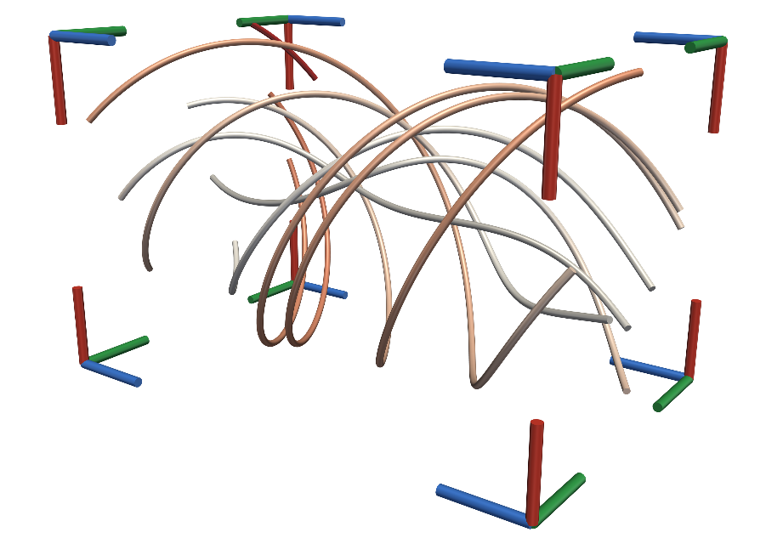
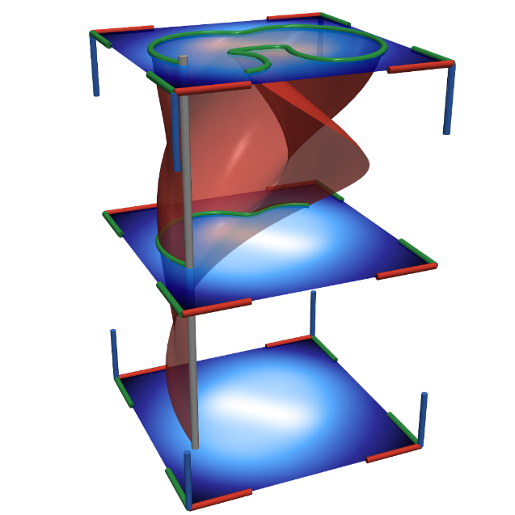
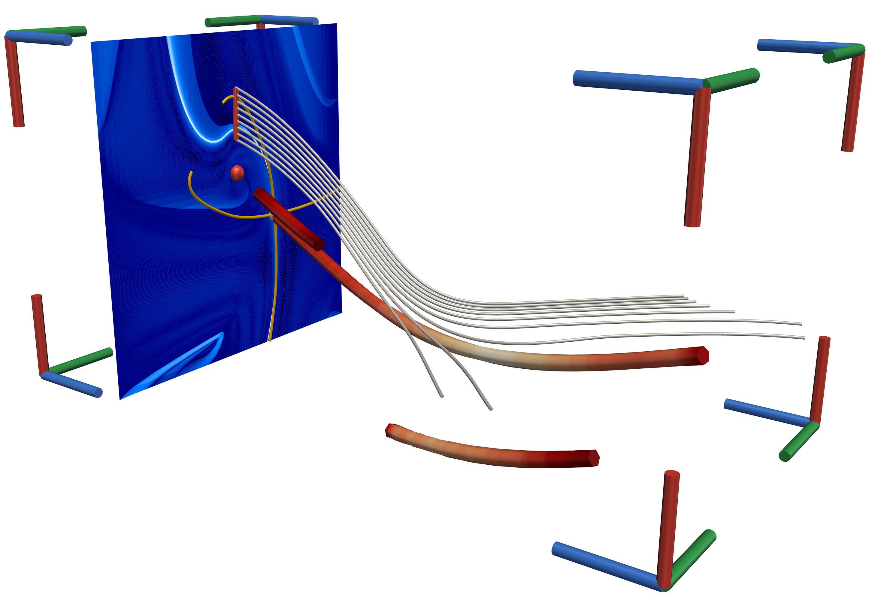
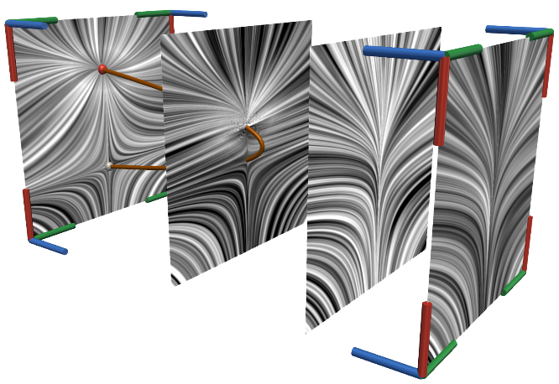
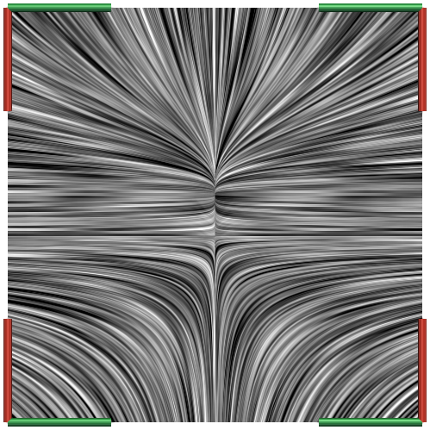
Overview
=
?
$$∘$$
Time
Time
Time
Time
Time
Fundamentals
Frame of Reference
Determination of Observer Field
[Hadwiger et al. 2019], [Günther et al. 2017/18]
Techniques
Time
Time
Time
Q1. General Applicability
Q2. Transfer of Techniques
Conclusion & Future Work

Slide 7
Fundamentals
Vector field $(here:n=2)$
Steady $u\left(x\right) :ℝ^{n}→ℝ^{n}$
Time-dependent $u\left(x,t\right):ℝ^{n}×ℝ→ℝ^{n}$
Characteristic curves
Streamlines: $\dot{x}=u\left(x\right),$ $x\left(t_{0}\right)=x_{0}$
Pathlines: $\dot{x}=u\left(x,t\right),$ $x\left(t_{0}\right)=x_{0}$
Space-time unsteady vector field $u\left(x,t\right)$
Time as additional dimension
$$\hat{u}\left({x \atop t}\right)=\left({u\left(x,t\right) \atop 1}\right)$$
Streamlines of $\hat{u}⇔$ pathlines of $u$
Time
Time

Slide 8
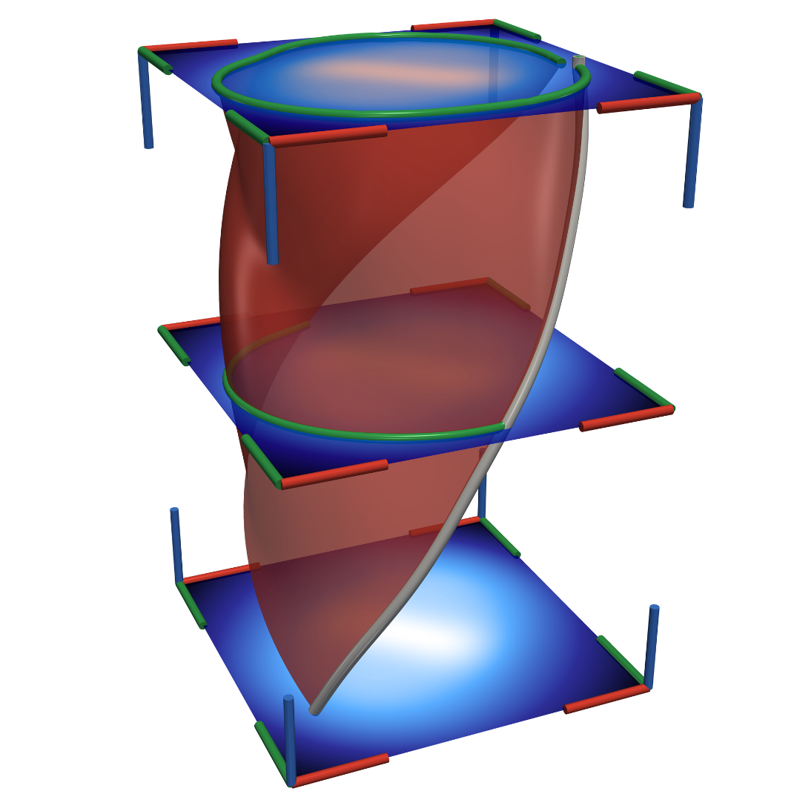
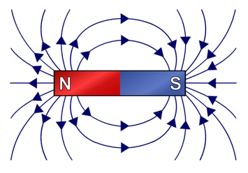
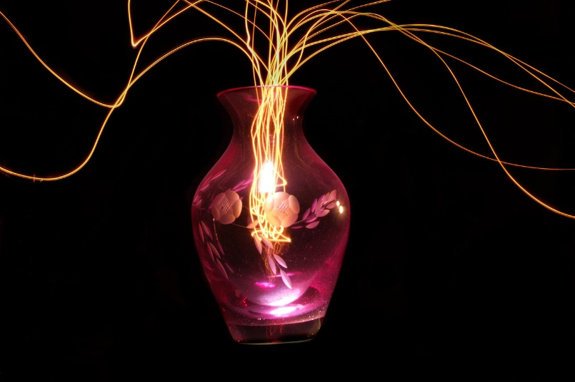
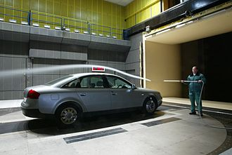
Characteristic Curves of Vector Fields
Streamlines
Pathlines
Streaklines
Time
Time
Time
Time
Seed
brilliant.org/wiki/magnetic-field-lines/
Wikipedia: Light painting
Wikipedia: Streaklines

Slide 9
Overview
=
?
$$∘$$
Time
Time
Time
Time
Time
Fundamentals
Frame of Reference
Determination of Observer Field
[Hadwiger et al. 2019], [Günther et al. 2017/18]
Techniques
Time
Time
Time
Q1. General Applicability
Q2. Transfer of Techniques
Conclusion & Future Work

Slide 10
Observer Motion
Lab Frame
Constant
Translation
Rigid Body Motion
$x+t c+c_{0}$
$R\left(t\right)x+c\left(t\right)$
$R∈SO_{3}$
Günther & Theisel. 2018

Slide 11
Frame of Reference (FOR)
Reference orientation and location
Frame of reference (FOR) $⇔$ observer
Example:
Ball thrown in the air on a moving train
Translation between observers
$$g:ℝ^{n}×ℝ→ℝ^{n}$$
Time-dependent
Observer motion $x^{∗}=R\left(t\right)x+c(t)$
Rotation: $R\left(t\right)$
Translation: $c\left(t\right)$
Observer on Train
Observer at Station
$$g$$
Time
Time

Slide 12
Representation of Observer Motion as Vector Field $I$
Decomposition of original vector field u$(x,t)$
Observer vector field $v\left(x,t\right)$
Steady vector field
With coordinate transform: $w\left(x,t\right)$
Without coordinate transform: $u_{v}=u−v$
Translation between observers $g$: $u_{v}↔$ $w$
Defined by observer vector field $v\left(x,t\right)$
$$v\left(x,t\right)↔x^{∗}=R\left(t\right)x+c(t)$$
=
[Günther et al. 17/18]
[Hadwiger et al. 2019]
$$g$$
$$∘$$
Time
Time
Time
Time
Time-dependent u$(x,t)$
Observer $v(x,t)$
Steady
$$w(x,t)$$
$$u_{v}=u−v$$

Slide 13
Representation of Observer Motion as Vector Field $II$
Observer vector field $v(x,t)$
Observer motion $x^{∗}=R\left(t\right)x+c(t)$
$c\left(t\right) ↔$ pathlines of $v$
$R\left(t\right)$ $↔$ diffential motion of $v$
Flow Map: $φ_{t_{0}}^{τ}:ℝ^{n}→ℝ^{n}, x_{0}↦φ_{t_{0}}^{τ}\left(x_{0}\right)$
map $x_{0}$ at $t_{0}$ to end point after advection time $τ$
Transform between $u_{v}↔$ $w$ using $v$
Map pathlines in $u\left(x,t\right)→$pathlines in $w\left(x,t\right)$
$$w_{t−τ}\left(x,t\right)=∇φ_{t−τ}^{−τ}\left(φ_{t}^{τ}\left(x\right)\right) \left(u_{v}\left(φ_{t}^{τ}\left(x\right),t\right)\right)$$
$$g$$
Time
Time
$$w(x,t)$$
$$u_{v}(x,t)$$
$$φ_{t_{0}}^{τ}\left(x_{0}\right)$$
$$x_{0}$$
pathline

Slide 14
Overview
=
?
$$∘$$
Time
Time
Time
Time
Time
Fundamentals
Frame of Reference
Determination of Observer Field
[Hadwiger et al. 2019], [Günther et al. 2017/18]
Techniques
Time
Time
Time
Q1. General Applicability
Q2. Transfer of Techniques
Conclusion & Future Work

Slide 15
Determination of Observer Field [Hadwiger et al. 2019], [Günther et al. 2017/18]
Steadiness depends on the observer
Steady for one observer
Unsteady for another (moving) observer
Method [Hadwiger et al. 2019], [Günther et al. 2017/18]
Find appropriate FOR
Observed field becomes steady
Not always possible!
Local property
Describe infinitely many observers
Observer vector field

Slide 16
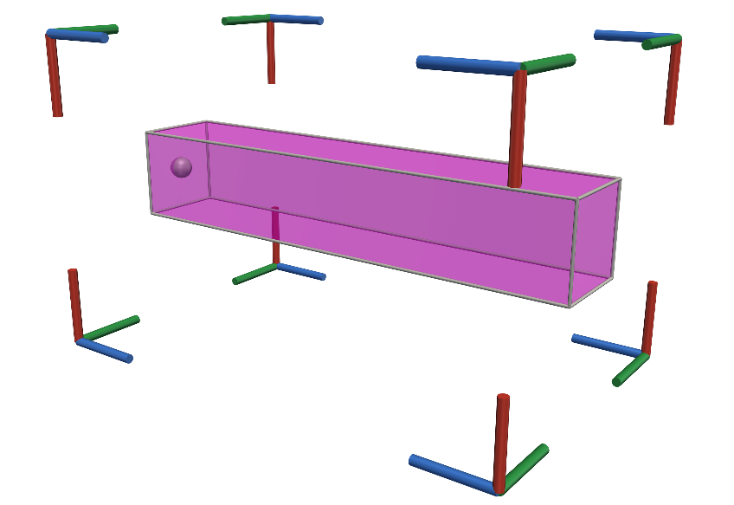
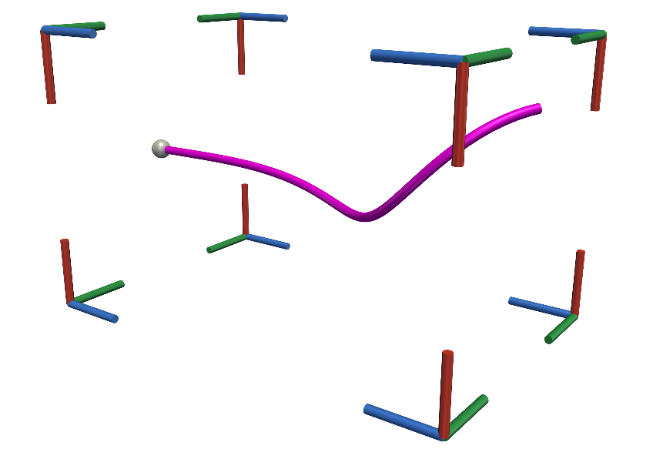
Determination of Observer Field [Hadwiger et al. 2019], [Günther et al. 2017/18]
Generic (Hyper)Objective Vortices [Günther et al. 2017 & Günther and Theisel 2018]
Neighborhood-based
Local fitting of velocity and derivatives
Discontinuous derivatives
Approximate Observer Killing Vector Fields [Hadwiger et al. 2019]
Derivative-based
Global optimization
High computational cost
Time
Time
$$v_{Günther}$$
=
$$∘$$
$$v_{Hadwiger}$$
Time
Time
Time
Time
u
$$v$$
$$w$$
$$u_{v}$$

Slide 17
Overview
=
?
$$∘$$
Time
Time
Time
Time
Time
Fundamentals
Frame of Reference
Determination of Observer Field
[Hadwiger et al. 2019], [Günther et al. 2017/18]
Techniques
Time
Time
Time
Q1. General Applicability
Q2. Transfer of Techniques
Conclusion & Future Work

Slide 18
General Applicability & Transfer of Techniques
Until here: State-of-the-art
Q1. Can vector fields always be decomposed in an observer and a steady field?
Q2. Can techniques be transferred from the steady to the time-dependent case?
Techniques
=
[Günther et al. 17/18]
[Hadwiger et al. 2019]
$$∘$$
Time
Time
Time
Time
Steady
Time-dependent u$(x,t)$
Observer $v(x,t)$
$$w(x,t)$$
$$u_{v}(x,t)$$

Slide 19
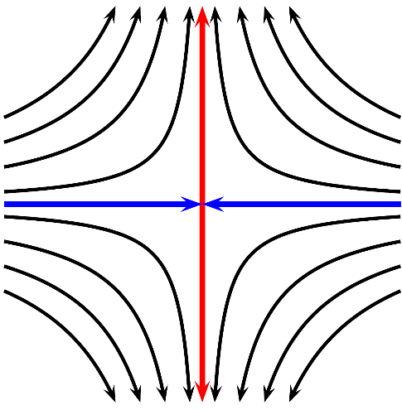
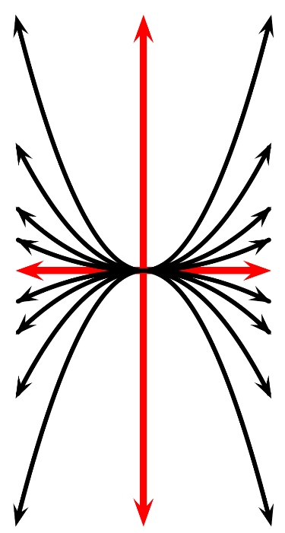
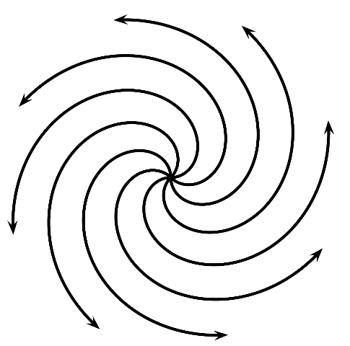
Vector Field Topology
Steady case
Vector field $u\left(x\right) :ℝ^{n}→ℝ^{n} (here:n=2)$
Critical points (spheres)
Isolated zeros
Classification by eigenvalues of $∇u$
sinks(blue), sources(red), saddles(gray)
Separatrices (yellow)
Separate regions of different behavior
Special streamlines
Filip Sadlo, PhD Dissertation

Slide 20
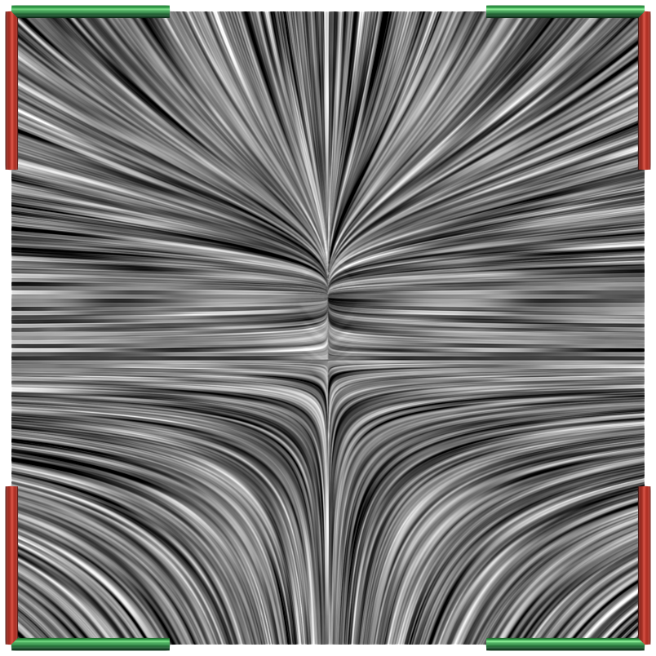
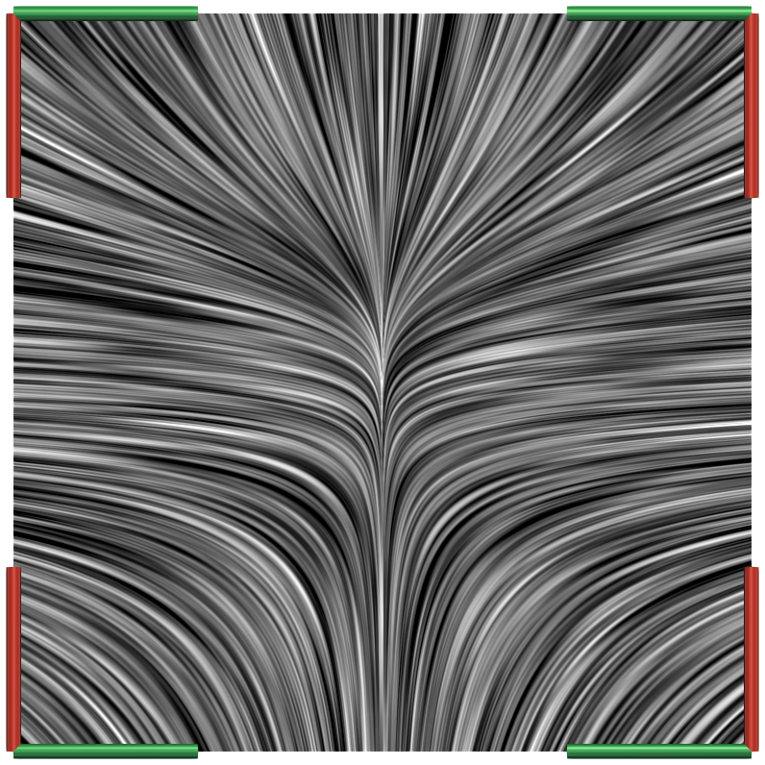
Q1. Steadification: Fold Bifurcation
Critical points
Isolated zeros
Classification by eigenvalues of $∇u$
sinks(blue), sources(red), saddles(gray)
Fold bifurcation
Birth and death of critical points
In pairs
Saddle + focus/node
$$u\left(x,y,r\right)=\left({rx−x^{2} \atop y}\right)$$
Decrease $r$ over time
$$r>0$$
$$r=0$$
$$r<0$$
Time
$$u(x,t)$$

Slide 21
Q1. Steadification: Fold Bifurcation
Typical phenomenon in flows
Critical points
Present in $t_{0}$ and $t_{1}$
Not present in $t_{2}$ and $t_{3}$
$w(x,t)$ is not steady! ✘
Neither method can find fitting FOR [Hadwiger et al. 2019], [Günther et al. 2017/18]
Does not work for all vector fields!
Time
$$u_{v}(x,t)$$
Time
$$w(x,t)$$

Slide 22
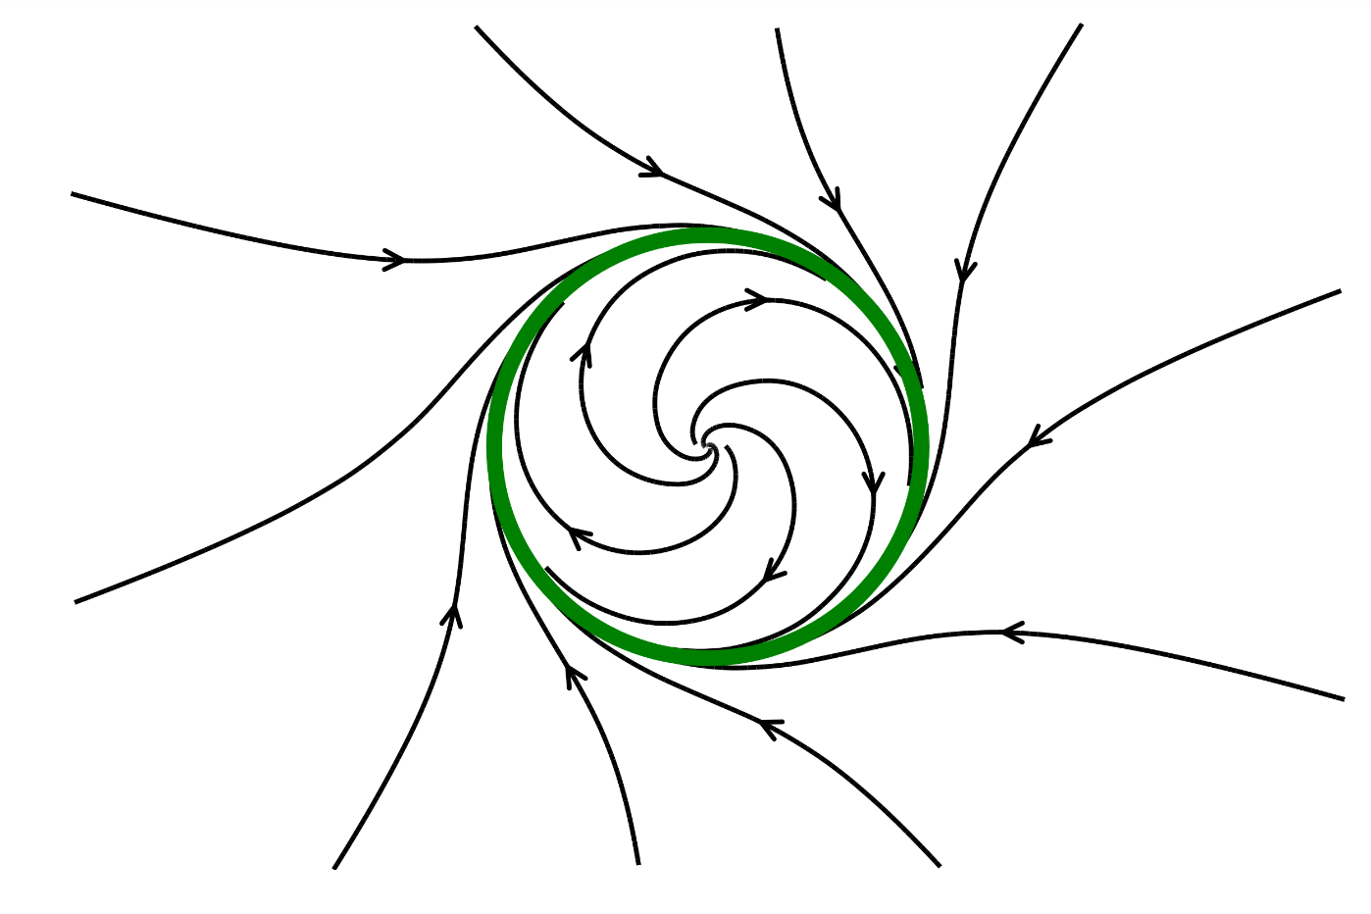
Q1. Steadification: Hopf Bifurcation
Hopf bifurcation
Change of stability of a critical point
Birth of a limit cycle
Expands outward
Example
From repelling focus (red sphere)
To attracting focus (blue sphere)
$$u\left(x,y,μ\right)=\left({μx−y+x −y^{2} \atop x+μy+y^{3}}\right)$$
Decrease $μ$ over time
Adapted from Lutz Hofmann
Time
$$u(x,t)$$

Slide 23
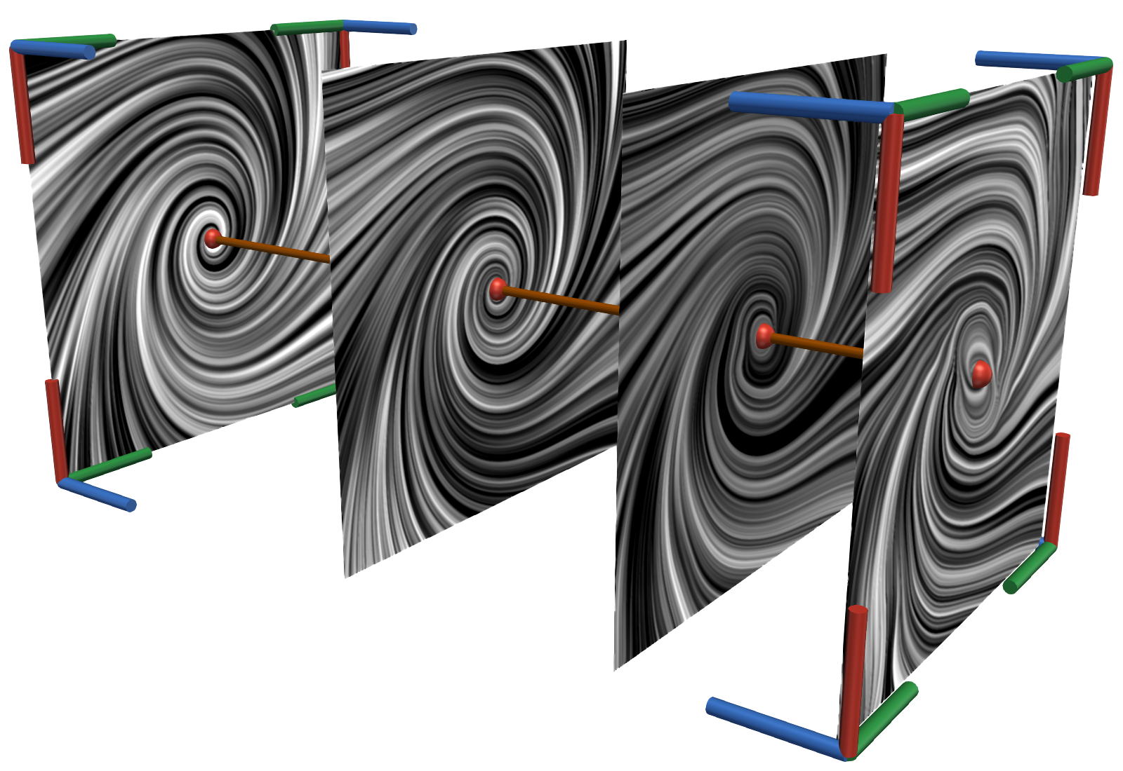
Q1. Steadification: Hopf Bifurcation
Approximate observer Killing vector fields [Hadwiger et al. 2019]
$w(x,t)$ steady ✔
Absorbs limit cycle
Limit cycle migrates: $u\left(x,t\right)→v\left(x,t\right)$
Limit cycle in observer vector field $v$
Less information in $w$
Consider $v$during visualization!
Generic (hyper)objective vortices [Günther et al. 2017/18]
$w(x,t)$ not steady ✘
Not able to find fitting FOR
Time
$$w(x,t)$$
Time
$$v(x,t)$$

Slide 24
Overview
=
?
$$∘$$
Time
Time
Time
Time
Time
Fundamentals
Frame of Reference
Determination of Observer Field
[Hadwiger et al. 2019], [Günther et al. 2017/18]
Techniques
Time
Time
Time
Q1. General Applicability
Q2. Transfer of Techniques
Conclusion & Future Work

Slide 25
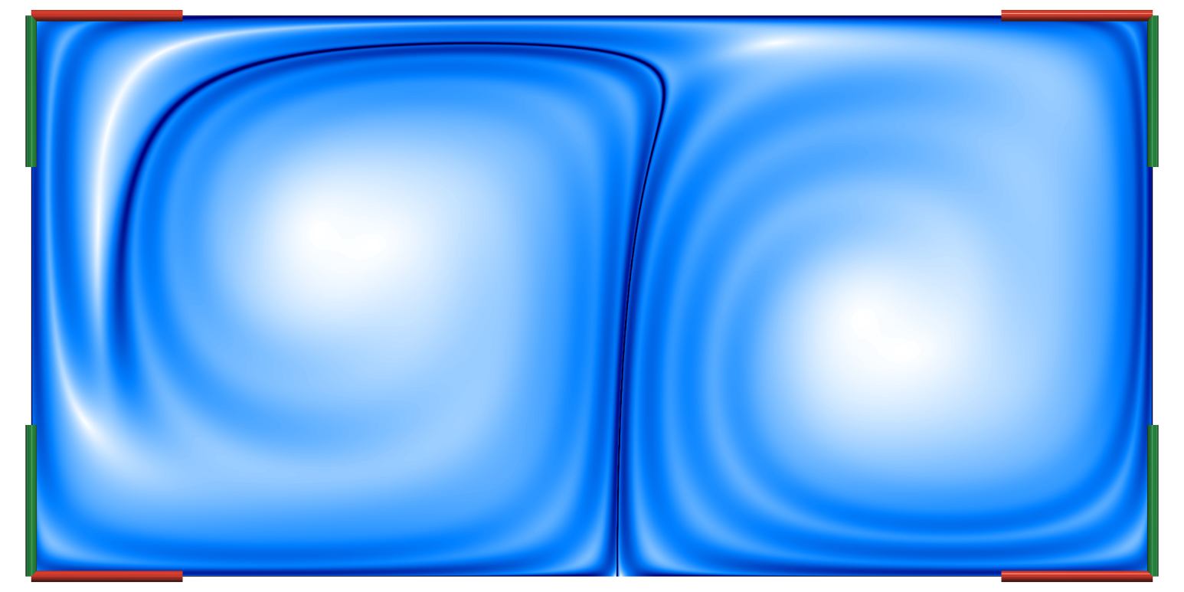
(Steady) Vector Field Topology
Steady case
Critical points (spheres)
sinks(blue), sources(red), saddles(gray)
Separatrices (yellow)
Separate regions of different behavior
Time-dependent case
Saddles → Hyperbolic trajectories
Separatrices → Lagrangian Coherent Structures

Slide 26
The Finite-Time Lyapunov Exponent (FTLE)
Spread of pathlines after advection time $τ$
Measure by gradient of flow map $∇φ_{t_{0}}^{τ}\left(x_{0}\right)$
FTLE: $σ_{t_{0}}^{τ}\left(x_{0}\right)=\frac{1}{\left|τ\right|}\ln{{\left\|∇φ_{t_{0}}^{τ}\left(x_{0}\right)\right\|}_{2}}$
Ridges indicate separating structures
Lagrangian coherent structures
$$t_{0}+τ$$
$$t_{0}$$
$$x_{0}$$
$$δ$$
$$Δ$$
$$t_{0}$$
$$t_{0}+τ$$
Ridge

Slide 27
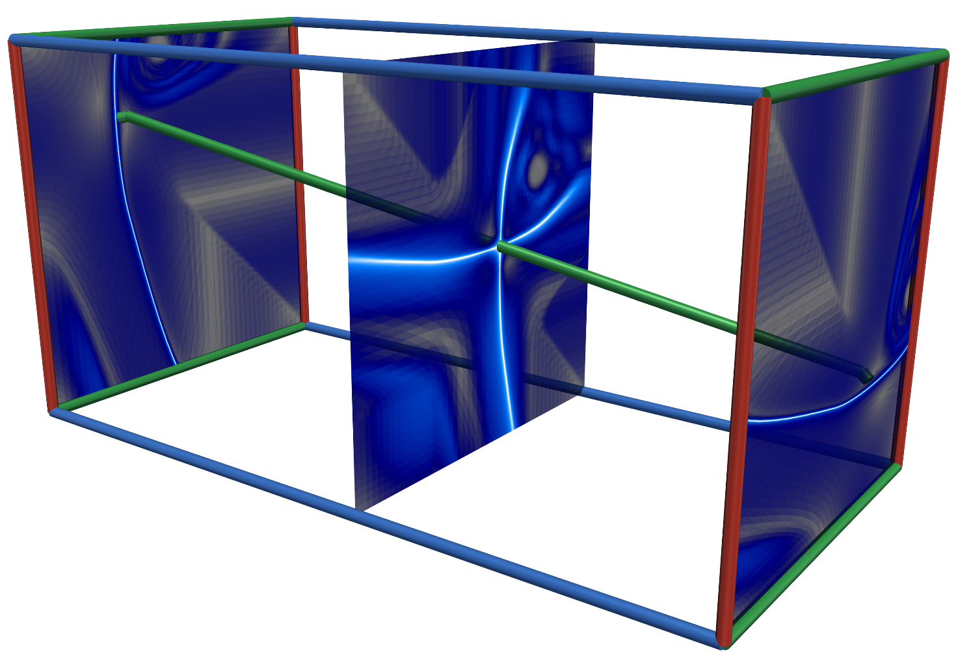
Lagrangian Coherent Structures (LCS)
Lagrangian coherent structures (LCS)
Separate particles in time-dependent flow
FTLE ridges
Advect with the flow
Hyperbolic trajectories (HT)
LCS intersections
Ridge/LCS
http://www.scienceclarified.com/Ga-He/Glacier.html
LCS

Slide 28
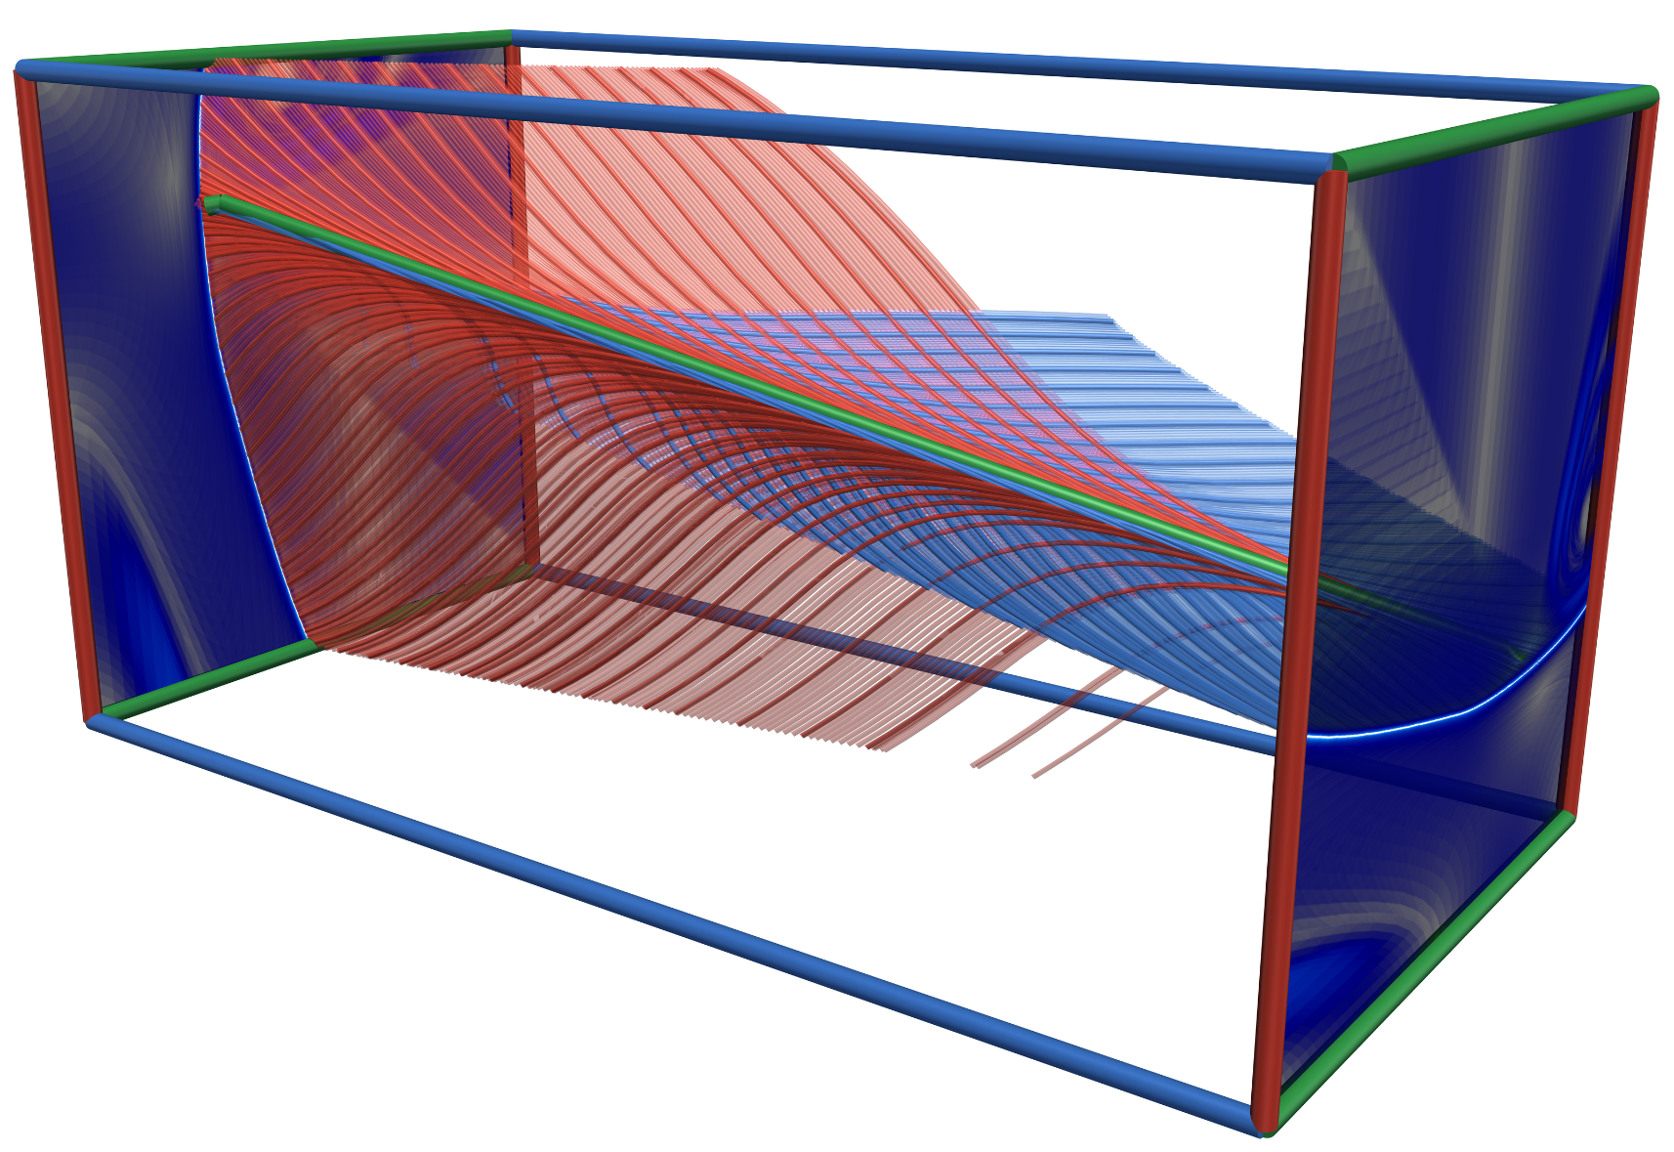
Streak-Based Vector Field Topology
Streak-Based Vector Field Topology [Sadlo & Weiskopf 2010, Üffinger et al. 2013]
Extract hyperbolic trajectory
LCS intersections: FTLE ridges forward/reverse time [Bachthaler et al. 2012]
Computationally expensive
2D: Bifurcation line in space-time [Machado et al. 2016]
Seed streak manifolds along HT in forward/reverse time
Bifurcation line
Separating 3D streamline
Extraction in space-time
Parallel vectors operator
streak manifold
Time
FTLE ridge

Slide 29
Parallel Vectors Operator (PV) [Peikert & Roth 1999]
Loci where two vector fields are parallel
Steady 3D vector fields only
2D time-dependent in space-time
Extraction of bifurcation lines
Vortex core criterion (SH) [Sujudi and Haimes 1995]
$u∥\left(∇u\right)u$ with $\det{∇u<0}$
Velocity $u$ parallel acceleration $a=\left(∇u\right)u$
Issue: Curved bifurcation lines
$u,a$ not parallel when solution is curved
PV solutions need not be streamlines
Application in 2D space-time implies equivalence
u
u
a
a
Bifurcation Lines
2D unsteady vector fields: $u,v$
$$\hat{u}∥\hat{v}⇔\hat{u}×\hat{v}=0$$
$$\hat{u}×\hat{v}=\left(\begin{matrix}u_{2}−v_{2} \\ v_{1}−u_{1} \\ \det{(u,v)}\end{matrix}\right)=0⇔u=v$$

Slide 30
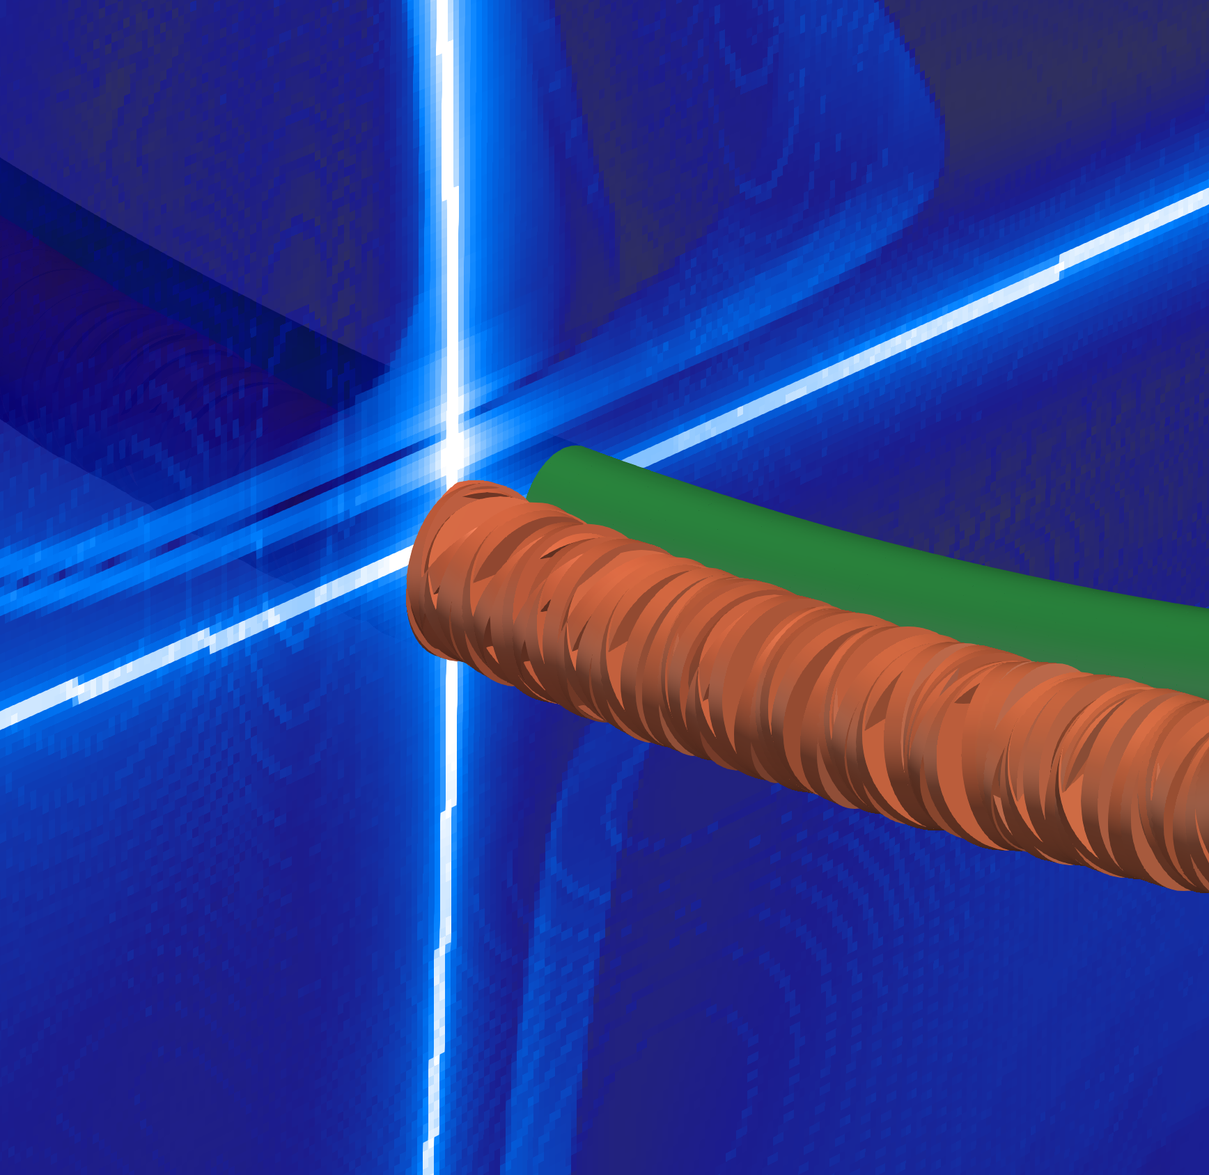
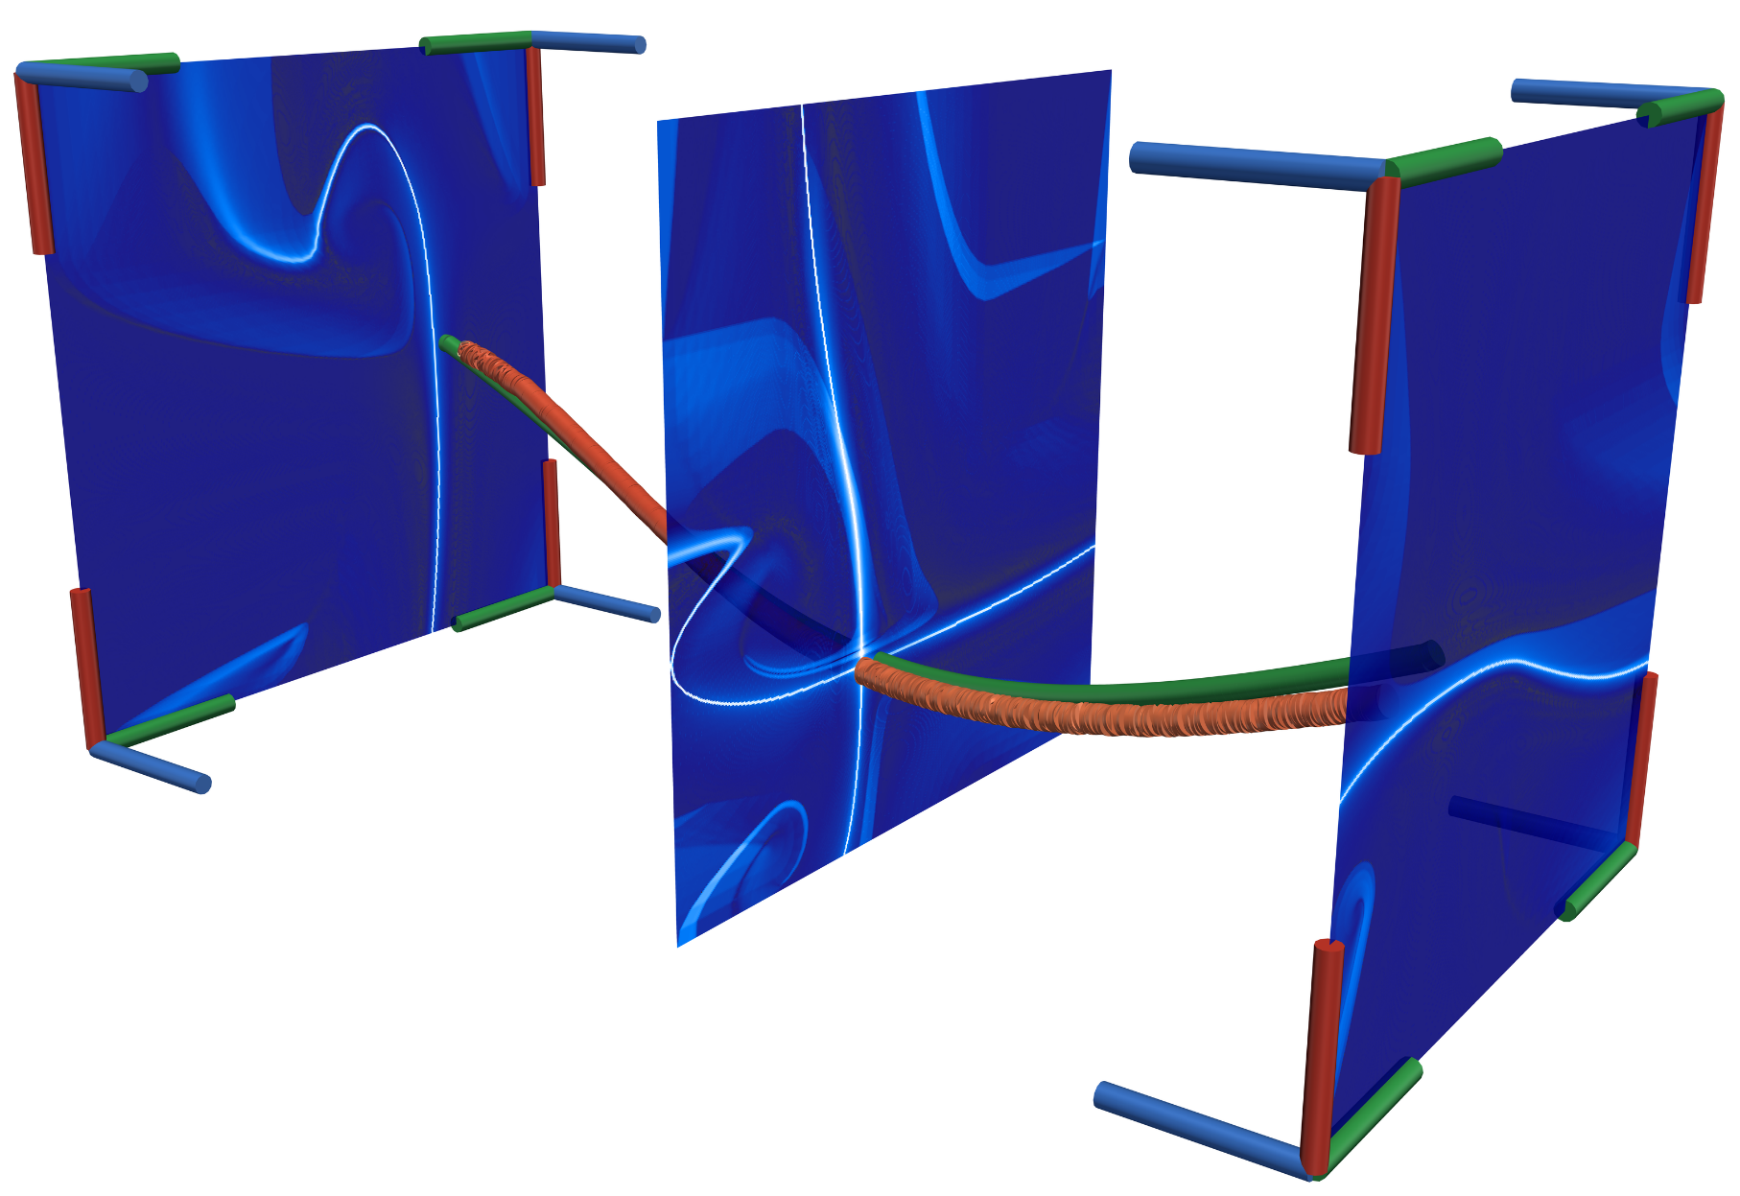
Q2. Transfer of Techniques: Steady Vector Field Topology
Comparison to streak-based vector field topology
1. HT as saddle-type critical point in steady-field $w$
Fitted to nearby streamlines
Time

Slide 31
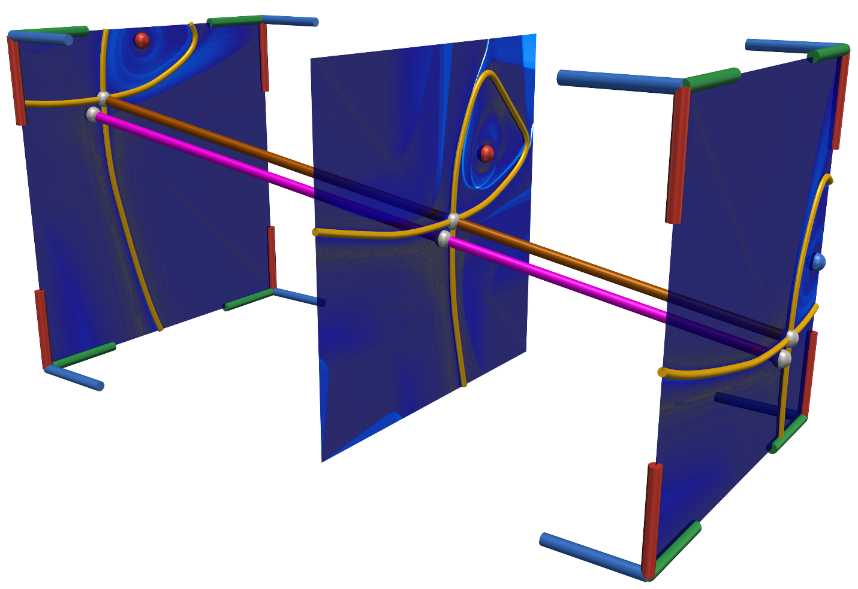
Q2. Transfer of Techniques: Steady Vector Field Topology
Comparison to streak-based vector field topology
2. Invariant manifolds
HT: saddle in steady-as-possible field $w$
Separatrices in steady field $w$
Seeded from saddle-type critical point
Corresponding observer pathlines
Uniform motion
Describe a single global observer
What if observer motion is non-uniform?
Time
Separatrix $=$ LCS
v$(x,t)$
Time

Slide 32
Q2. Transfer of Techniques: Steady Vector Field Topology
Comparison to streak-based vector field topology
Non-uniform observer motion
2. Invariant manifolds
Deviate from FTLE ridge
Streamlines (gray)
Separated by FTLE ridge
But not by separatrix
Streak manifolds work well
Attracting in forward/reverse time
No need to use separatrices
Time
Separatrix $≠$ LCS

Slide 33
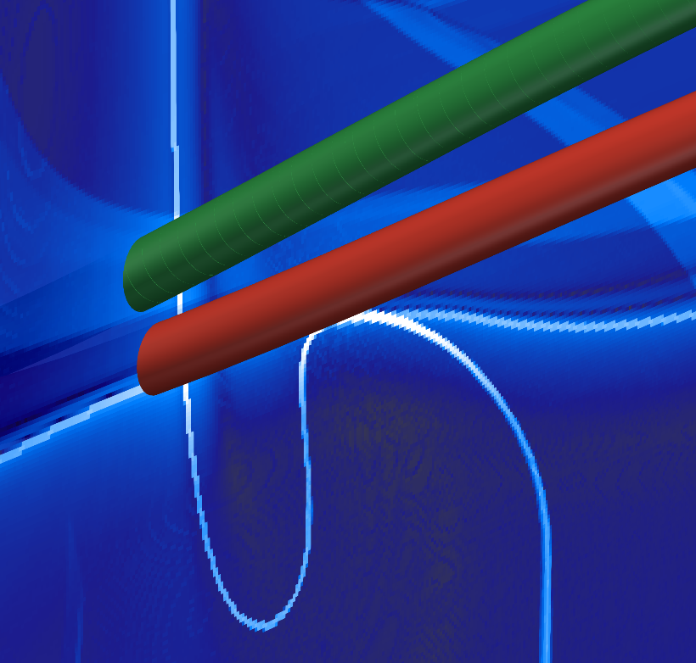
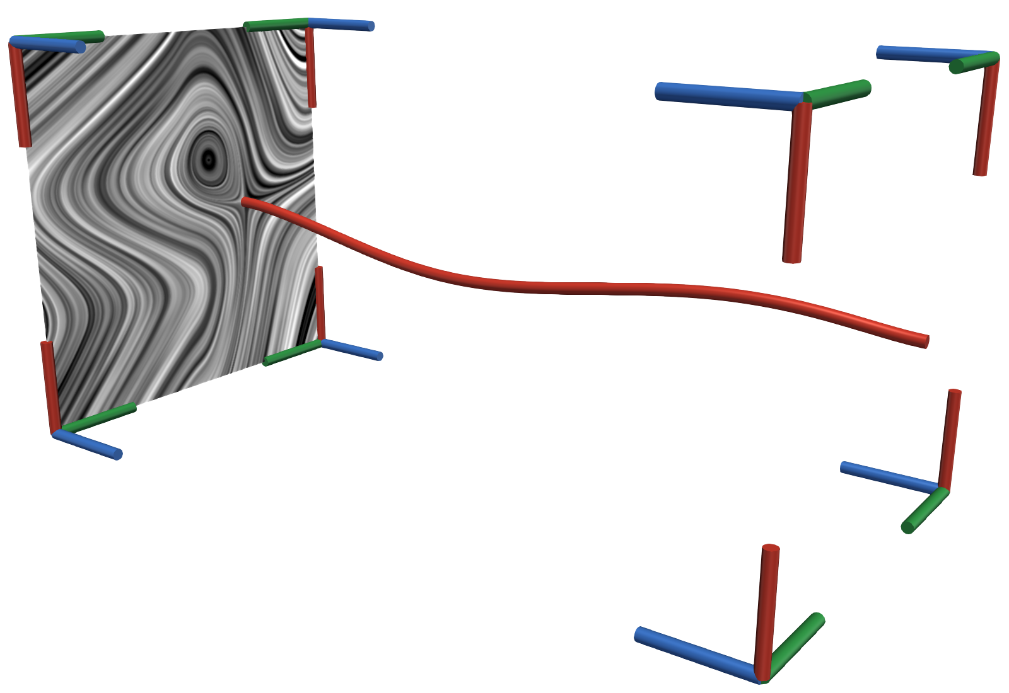
Q2. Transfer of Techniques: Steady Vector Field Topology
PV of original and observer vector field $\hat{u}∥\hat{v}$
Correspond to critical points of $w$
$$\hat{u}∥\hat{v}⇔u=v⇔u_{v}=w=0$$
Curved SH solutions $u∥a$
SH in $u_{v}$ curved (green)
SH in $w$ less curved (red)
$w$ is useful even when not steady
Time
u$(x,t)$
$$w(x,t)$$
Time

Slide 34
Q1/2 Steadification: Fold Bifurcation
Hotroom 2D
Cooled left side and heated right
Fluid mixes over time
Critical points in objective frame (spheres)
sinks(blue), sources(red), saddles(gray)
Shortly before fold bifurcation
Space-time streamlines not separated
No hyperbolic trajectory
False positive
Time

Slide 35
Overview
=
?
$$∘$$
Time
Time
Time
Time
Time
Fundamentals
Frame of Reference
Determination of Observer Field
[Hadwiger et al. 2019], [Günther et al. 2017/18]
Techniques
Time
Time
Time
Q1. General Applicability
Q2. Transfer of Techniques
Conclusion & Future Work

Slide 36
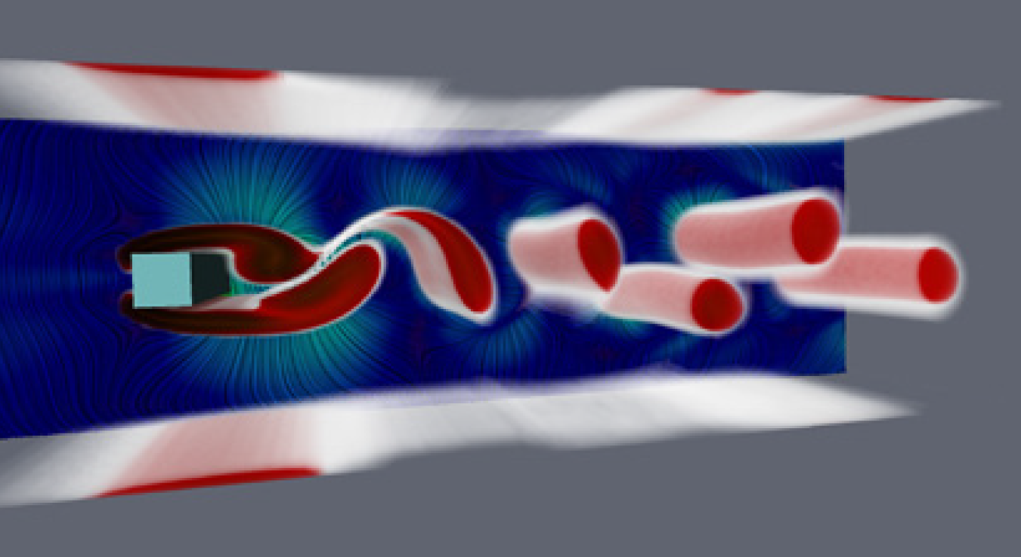
Extension to 3D
Methods support 3D time-dependent vector fields
[Hadwiger et al. 2019] & [Günther et al. 2017/18] ✔
Our implementation ✔
Fold and Hopf bifurcation exist
Steadification not possible
Limit cycle needs testing
Replace PV for vortices and hyperbolic trajectories
Coplanar vectors [Weinkauf et al. 2007]
PV of original and observer field correspond to critical points in steady field
[Hadwiger et al. 2019]
$$\hat{u}∥\hat{v}⇔u=v⇔w=0$$

Slide 37
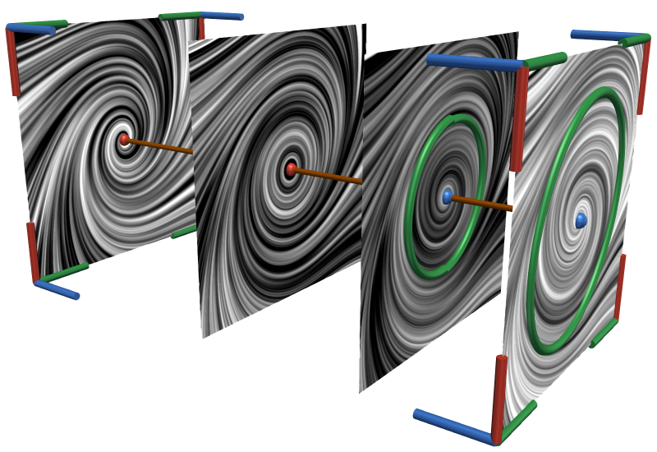
Conclusion
https://www.kisspng.com/png-check-mark-computer-icons-clip-art-green-tick-mark-568606/download-png.html
Dataset
Fold Bifurcation
No Bifurcation/
Hopf Bifurcation
Steadiness of steady-as-possible field $w$
Fold bifurcations
Hopf bifurcations
Depends on framework
Vortices and HTs as critical points
False positive vortices
Equivalence PV $u∥v⇔$ crit. points $w$
Improve curved $u∥a$
Application in steady field
Even if not truly steady
Time
$w$ unsteady
$w$ steady
Time
$u∥v⇔$ $w=u_{v}=0$
False Positive $u∥a$
(Vortices/HT) in $w$
Curved $u∥a$ in $u_{v}$
Improve in $w$
Vortices/HT as Crit. Points: $w=0$
Dataset
Hopf Bifurcation
Fold Bifurcation
$w$ is steady?
$u∥v⇔$ $w=u_{v}=0$
Objective Vortices/HT $u∥a$ in $u_{v}$
Curved $u∥a$ in $u_{v}$
Improve in $w$
False Positive $u∥a$
(Vortices/HT) in $w$
Vortices/HT as Crit. Points: $w=0$

Slide 38
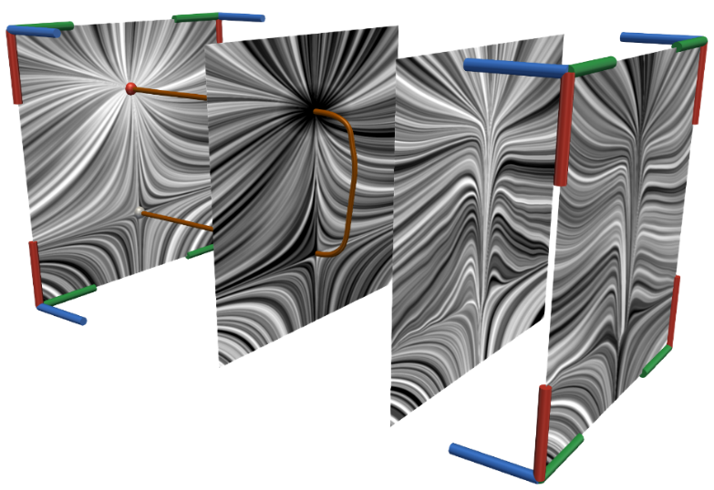
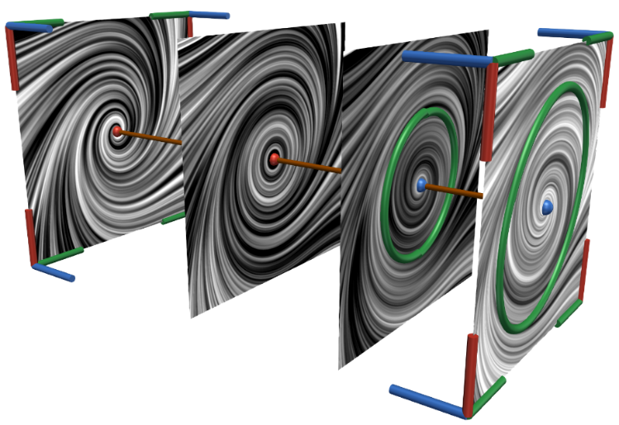
Conclusion
Q1. Not every vector field can be decomposed this way!
Fold bifurcations
Hopf bifurcations
Q2. Some methods can be transferred to the time-dependent case
If observed field is steady
Vortex core line & HT $⇔$ critical points
If observer field is uniform and steady
Separatrices $⇔$ LCS
Improvement for curved PV solutions
Straight forward extension to 3D

Slide 39
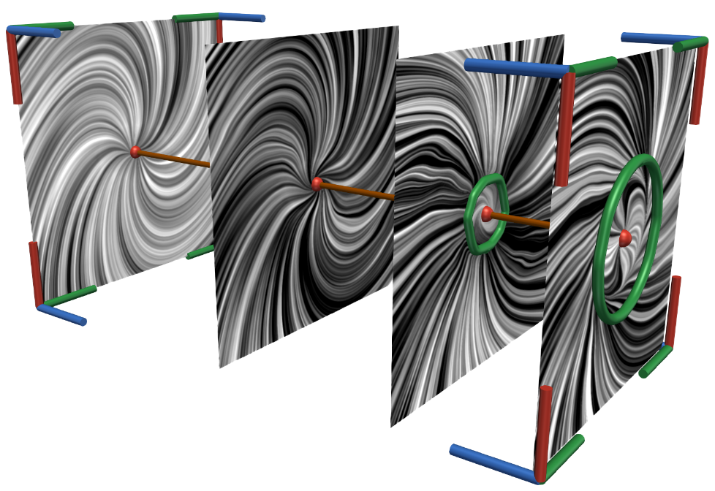
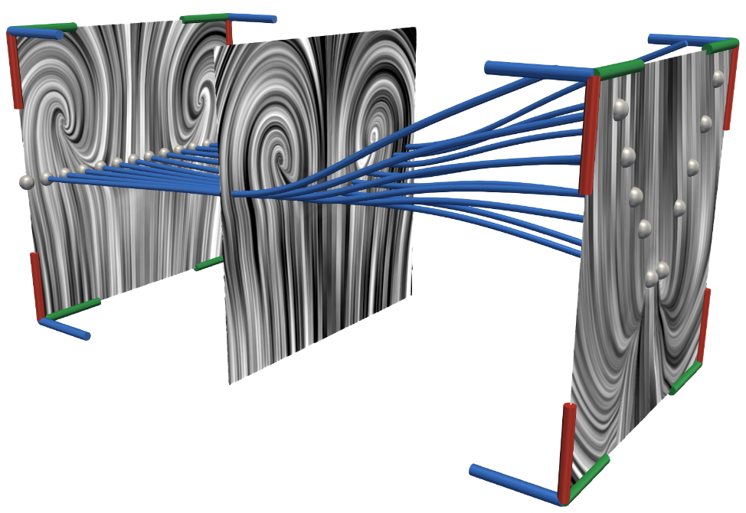
Future Work
Visualization of observer field
Show deviation from uniformity
Physical energies
Quantification of steadiness
Transfer of techniques if (slightly) unsteady
Feature extraction error
Apply other PV methods e.g., higher-order [Roth & Peikert 1999]
Partition space-domain of Hadwiger et al.
Compare with Günther et al.

Slide 40
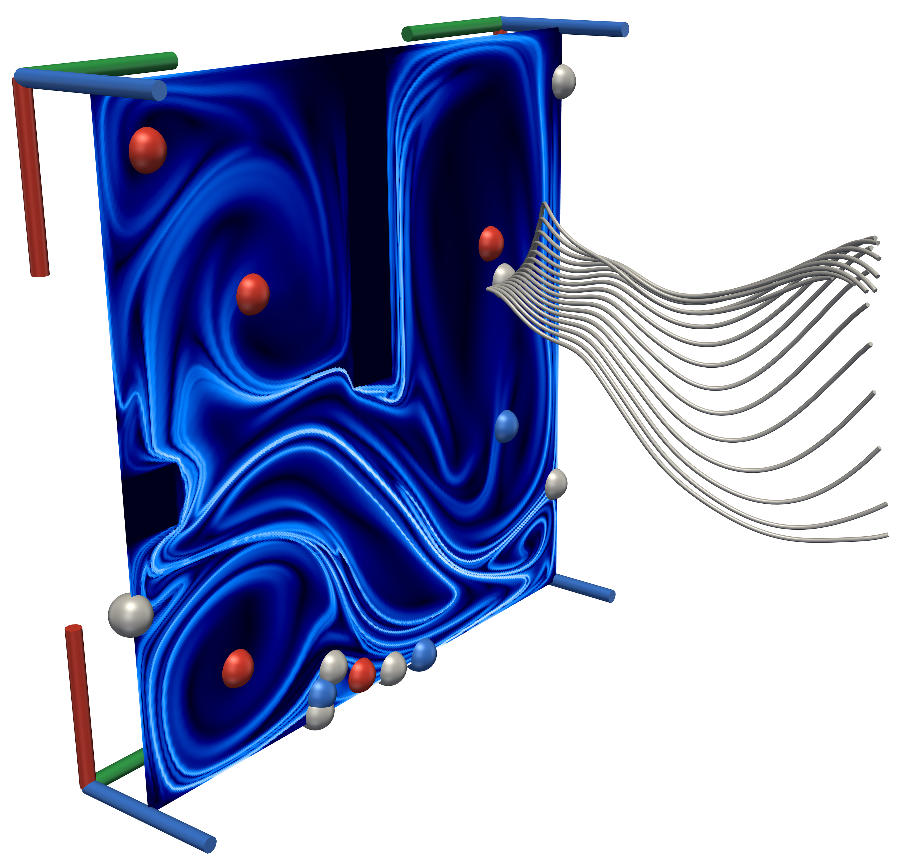
Thank you for your attention! Questions?

Slide 41
References $I$
Haller, G., Hadjighasem, A., Farazmand, M., & Huhn, F. (2016). Defining coherent vortices objectively from the vorticity. Journal of Fluid Mechanics, 795, 136-173.
Weinkauf, T., Sahner, J., Theisel, H., & Hege, H. C. (2007). Cores of swirling particle motion in unsteady flows. IEEE Transactions on Visualization and Computer Graphics, 13(6), 1759-1766.
Günther, T., Schulze, M., & Theisel, H. (2016). Rotation invariant vortices for flow visualization. IEEE Transactions on Visualization & Computer Graphics, (1), 1-1.
Günther, T., Gross, M., & Theisel, H. (2017). Generic objective vortices for flow visualization. ACM Transactions on Graphics (TOG), 36(4), 141.
Günther, T., & Theisel, H. (2018). Hyper-Objective Vortices. IEEE transactions on visualization and computer graphics.
Hadwiger, M., Mlejnek, M., Theußl, T., & Rautek, P. (2018). Time-Dependent Flow seen through Approximate Observer Killing Fields. IEEE transactions on visualization and computer graphics.
Jeong, Jinhee, and Fazle Hussain. "On the identification of a vortex." Journal of fluid mechanics 285 (1995): 69-94.
Peikert, Ronald, and Martin Roth. "The “parallel vectors” operator: a vector field visualization primitive." Proceedings of the conference on Visualization'99: celebrating ten years. IEEE Computer Society Press, 1999.
Sujudi, David, and Robert Haimes. "Identification of swirling flow in 3-D vector fields." 12th Computational Fluid Dynamics Conference. 1995.
Sahner, Jan, Tino Weinkauf, and Hans-Christian Hege. "Galilean invariant extraction and iconic representation of vortex core lines." EuroVis. 2005.

Slide 42
References $II$
Haller, G., Hadjighasem, A., Farazmand, M., & Huhn, F. (2016). Defining coherent vortices objectively from the vorticity. Journal of Fluid Mechanics, 795, 136-173.
Weinkauf, T., Sahner, J., Theisel, H., & Hege, H. C. (2007). Cores of swirling particle motion in unsteady flows. IEEE Transactions on Visualization and Computer Graphics, 13(6), 1759-1766.
Machado, G., Boblest, S., Ertl, T., & Sadlo, F. (2016, June). Space‐time bifurcation lines for extraction of 2D Lagrangian coherent structures. In Computer Graphics Forum (Vol. 35, No. 3, pp. 91-100).
Machado, G. M., Sadlo, F., & Ertl, T. (2013). Local Extraction of Bifurcation Lines. In VMV (pp. 17-24).
Uffinger, M., Sadlo, F., & Ertl, T. (2013). A time-dependent vector field topology based on streak surfaces. IEEE Transactions on Visualization and Computer Graphics, 19(3), 379-392.
Sadlo, F., & Weiskopf, D. (2010, March). Time‐dependent 2‐D vector field topology: An approach inspired by Lagrangian coherent structures. In Computer Graphics Forum (Vol. 29, No. 1, pp. 88-100). Oxford, UK: Blackwell Publishing Ltd.
Roth, M., & Peikert, R. (1998, October). A higher-order method for finding vortex core lines. In Proceedings Visualization'98 (Cat. No. 98CB36276) (pp. 143-150). IEEE.
Peikert, R., & Roth, M. (1999, October). The “parallel vectors” operator: a vector field visualization primitive. In Proceedings of the conference on Visualization'99: celebrating ten years (pp. 263-270). IEEE Computer Society Press.
Bachthaler, S., Sadlo, F., Dachsbacher, C., & Weiskopf, D. (2012). Space-time Visualization of Dynamics in Lagrangian Coherent Structures of Time-dependent 2D Vector Fields. In GRAPP/IVAPP (pp. 573-583).

Slide 43
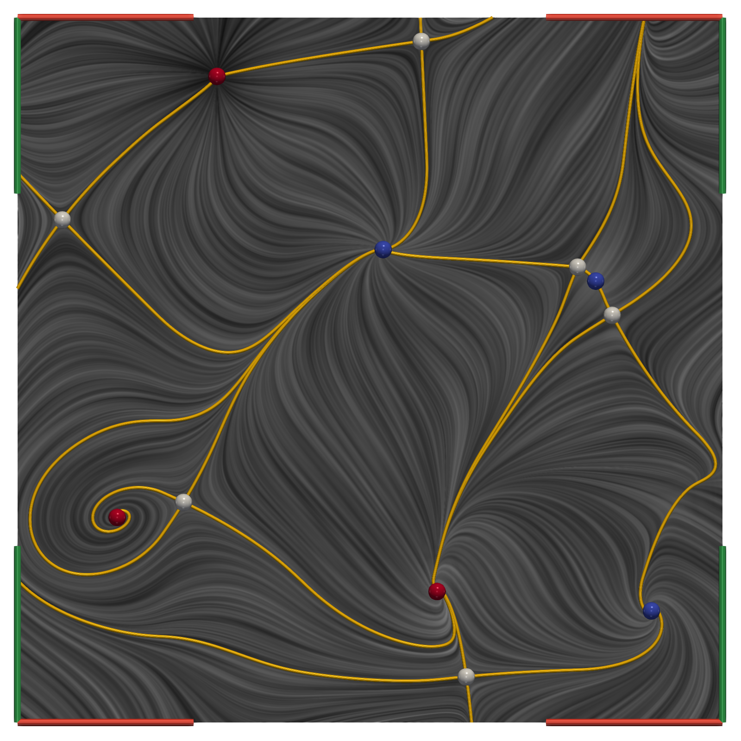
Streak Line topology
Replace Stream lines by streak lines (for separatrix generation)

Slide 44
Observer PV to Original [Small icon]
TODO
Check all sources
Backup slides with more images
Observer field add eye
Streamlines -> space-time streamline
Future Work
PV in original field correspondence to what in steady-as-possible field
FTLE in local frames
Vs in original frame
Investigate streamlines vs pathlines in steady-as-possible field

Slide 45
Observer Vector Fields

Slide 46
Motivation: von Kármán Vortex Street (2D)
Flow from left to right
Flow around obstacle (blue)
Moving vortices behind obstacle
Fixed Frame
Line Integral Convolution (LIC)
Vortex Indicator $λ_{2}$

Slide 47
Motivation: von Kármán Vortex Street (2D)
Flow from left to right
Flow around obstacle
Moving vortices behind obstacle
Feature extraction is frame-dependent
Vortices
Vector field topology
Moving Frame
Line Integral Convolution (LIC)
Vortex Indicator $λ_{2}$

Slide 48
Motivation: von Kármán Vortex Street (2D)
Flow from left to right
Flow around obstacle (blue)
Moving vortices behind obstacle
Feature extraction is frame-dependent
Vortices
Vector field topology
Multiple reference frames needed
Slower flow behind obstacle
Faster flow on top and bottom

Slide 49
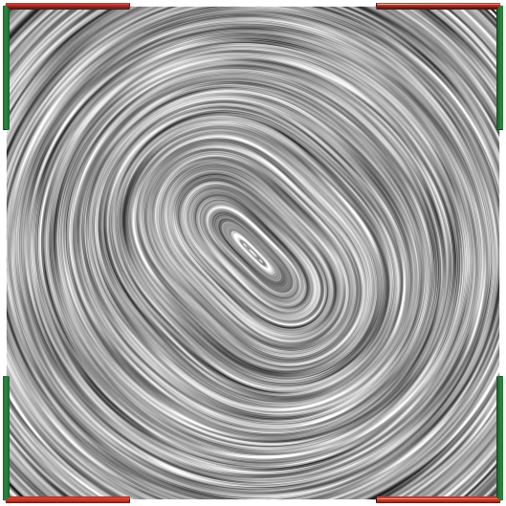
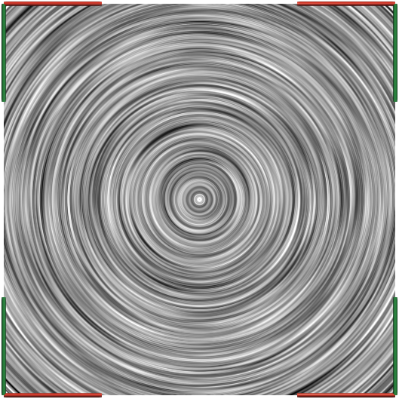
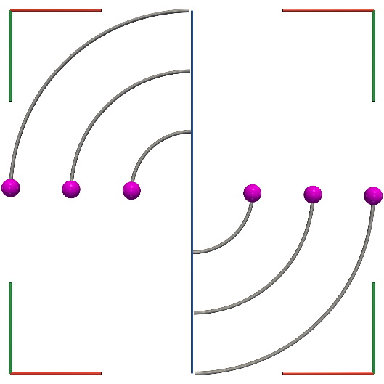
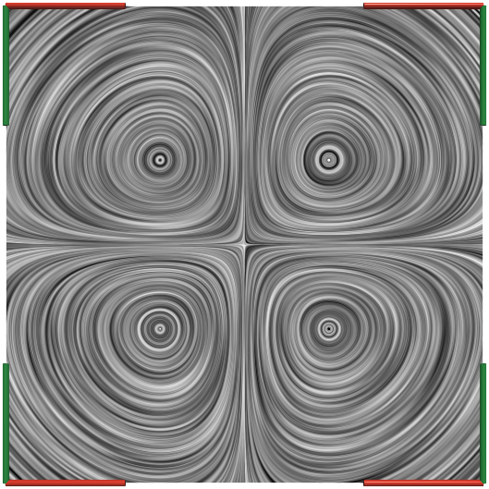
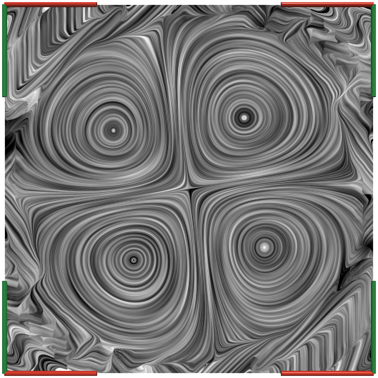
Translation Between Frames of Reference
Example
Four rotating vortices
LICs at $t_{0}$ of the different fields
Transformed field
Flow map computation
Observers exit domain
Treat with standard techniques
Clamp
Wrap
Not discussed in literature! [Hadwiger et al. 2019], [Günther et al. 2017/18]
$$u\left(x,t\right)$$
$$v\left(x,t\right)$$
$$w\left(x,t\right)$$
Initial Positions
Fixed Boundary
Clamp Boundary
Wrap Boundary

Slide 50
Approximate Observer Killing Vector Fields [Hadwiger et al. 2019]
Killing vector fields [Hadwiger et al. 2019]
Constrain observer motion
Local rigid body motion
$$∇u+{\left(∇u\right)}^{T}=0$$
Minimization problem
$$\arg{\min_{v}{\int_{Ω}{αK\left(v\right)+βL_{u}\left(v\right)+Re\left(v\right) dV}}}$$
Trade-off $α$ ⬄ $β$
Local rigid body motion $K\left(v\right)$
Steadiness $L_{u}\left(v\right)$
Change of $u\left(x,t\right)$ along $v\left(x,t\right)$
Regularization $Re\left(v\right)$
Observer similar to original field $u$
=
$$∘$$
Time
Time
Time
Time
u
$$v$$
$$w$$
$$u_{v}$$

Slide 51
Vortex Core Lines (Todo LIC of Focus)
Vortex core lines (pink)
Center axis of rotation
Parallel vectors (PV) problem [Peikert & Roth 1999]
Vortex core criterion [Sujudi and Haimes 1995]
$u∥\left(∇u\right)u$+ two complex eigenvalues of $∇u$
Velocity $u$ parallel acceleration $a=\left(∇u\right)u$
2D steady vector fields
Corresponds to focus-type critical points
u
a

Slide 52
Q2. Transfer of Methods: Vortex Core Lines
Example
Four rotating centers
Observer rotating clockwise
No visible vortex cores
Vortex core lines (pink)
$u∥a$ in original FoR: Wrong ✘
$u∥a$ in objective FoR: Correct ✔
Correspond to critical points in $w$
Streamlines (gray)
Swirl around correct solution
$$u(x,t)$$
Time
$$w(x,t)$$
Time

Slide 53
Steadifcation: Fold Bifurcation
Buoyant Plumes 2D
Heated top and cooled bottom
Turbulent flow
Fold bifurcations occur
Focus-type critical point with streamlines (gray)
Color coded feature angle
Angle: flow and core line tangent
False positive
Feature Angle ($°$)

Slide 54
Hyperbolic Trajectories
FTLE for different $t_{0}$ in space-time
Ridge surfaces: forward & backward
Hyperbolic trajectories (HT)
Invariant manifolds in space-time
Repelling manifold in forward and reverse time
Obtained as streak manifolds
Hyperbolicity (2D): $\det{∇u<0}$
Unsteady: HT $⇔$ saddle-type critical point
Time

Slide 55
Computation Times and Comparison
Generic (hyper)objective vortices [Günther et al. 2017/18]
Local optimization (neighborhood)
Easily parallelizable
CPU bound
Approximate observer Killing vector fields [Hadwiger et al. 2019]
Global optimization
Memory bound
Parallel CPU or GPU hard to realize

Slide 56
Representation of Observer Motion as Vector Field
Observe $u\left(x,t\right)$ while moving along $v\left(x,t\right)$
Transformation $g: u\left(x,t\right)→w\left(x,t\right)$
Map pathlines in $u\left(x,t\right)→$pathlines in $w\left(x,t\right)$
$$w_{r}\left(x,t\right)=∇Ψ_{t,r}^{v, −1}\left(Ψ_{t,r}^{v}\left(x\right)\right) \left(\tilde{w}\left(Ψ_{t,r}^{v}\left(x\right),t\right)\right)$$
Observer flow map $Ψ_{t,r}^{v}\left(x\right)$ defines $g$
FoR: $R\left(t\right)x+c\left(t\right)$ as vector field
$c\left(t\right) ↔$ pathlines of $v\left(x,t\right)$
$R\left(t\right)$ $↔$ diffential motion of $v\left(x,t\right)$
!?
=
+
$$v(x,t)$$
[Günther et al. 17/18]
[Hadwiger et al. 2019]
Time-dependent u$(x,t)$
Observer $v(x,t)$
$$\tilde{w}(x,t)$$
Steady
$$w(x,t)$$

Slide 57
Representation of Observer Motion as Vector Field $I$
Observer motion $x^{∗}=R\left(t\right)x+c(t)$
Rotation: $R\left(t\right)$
Translation: $c\left(t\right)$
Represent as vector field $v(x,t)$
Translation between observers $g$
Defined by observer vector field $v(x,t)$
$c\left(t\right) ↔$ pathlines of $v\left(x,t\right)$
$R\left(t\right)$ $↔$ diffential motion of $v\left(x,t\right)$
=
[Günther et al. 17/18]
[Hadwiger et al. 2019]
$$g$$
$$∘$$
Time
Time
Time
Time
Time
Time
Time-dependent
Observer $v(x,t)$
Steady

